Slide 1
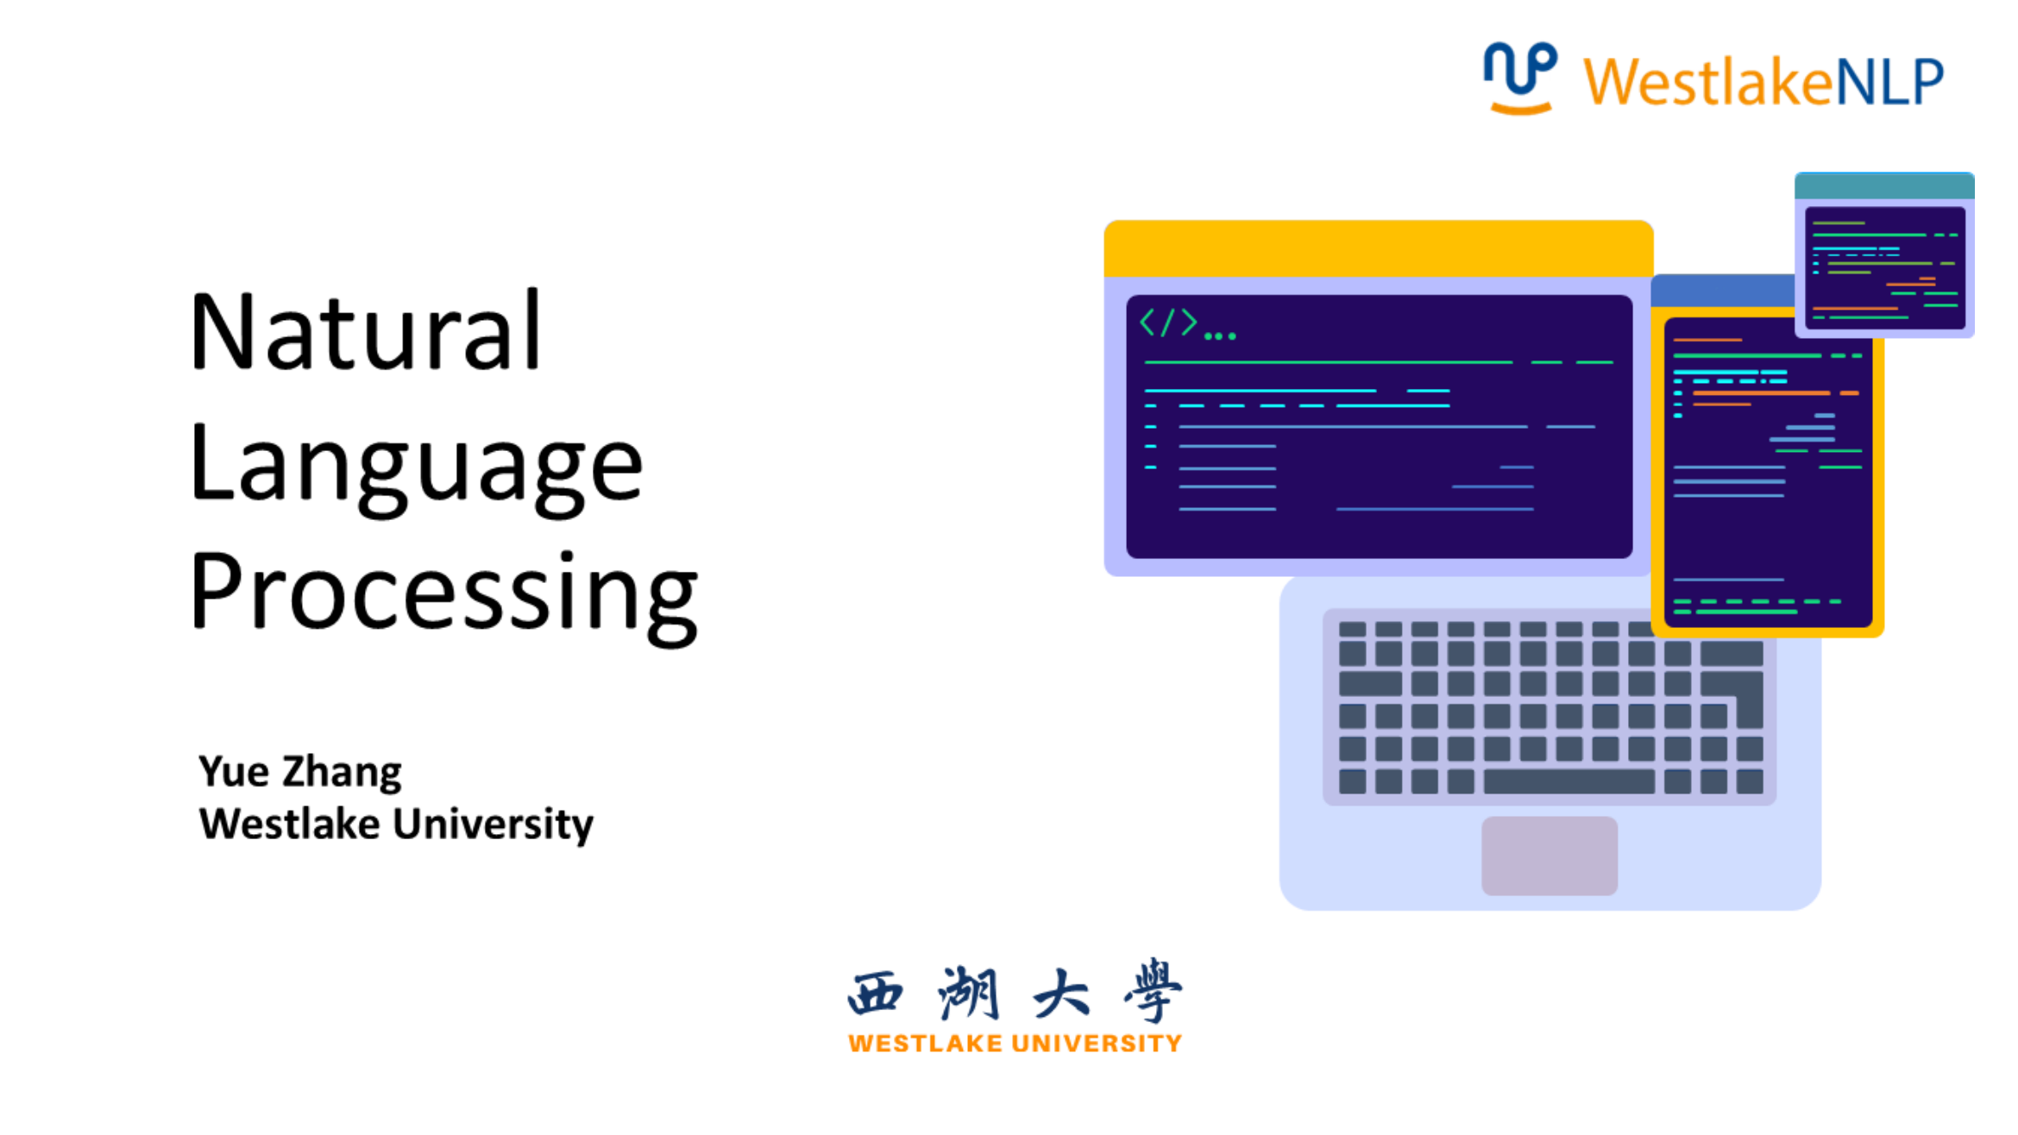

Slide 2
Transfer Learning
Pretraining from LM
Skip Gram, CBOW, ELMo
Pretraining beyond LM
Transferring knowledge from resource-rich tasks, domains, languages and annotation standards to low-resource ones.
e.g
syntactic resources pretraining for semantic role labeling.
corpora in news domain pretraining for low-resources social media.
English-French machine translation pretraining for English-Uzbek.

Slide 3
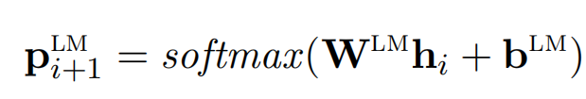
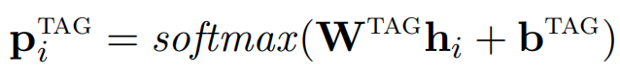
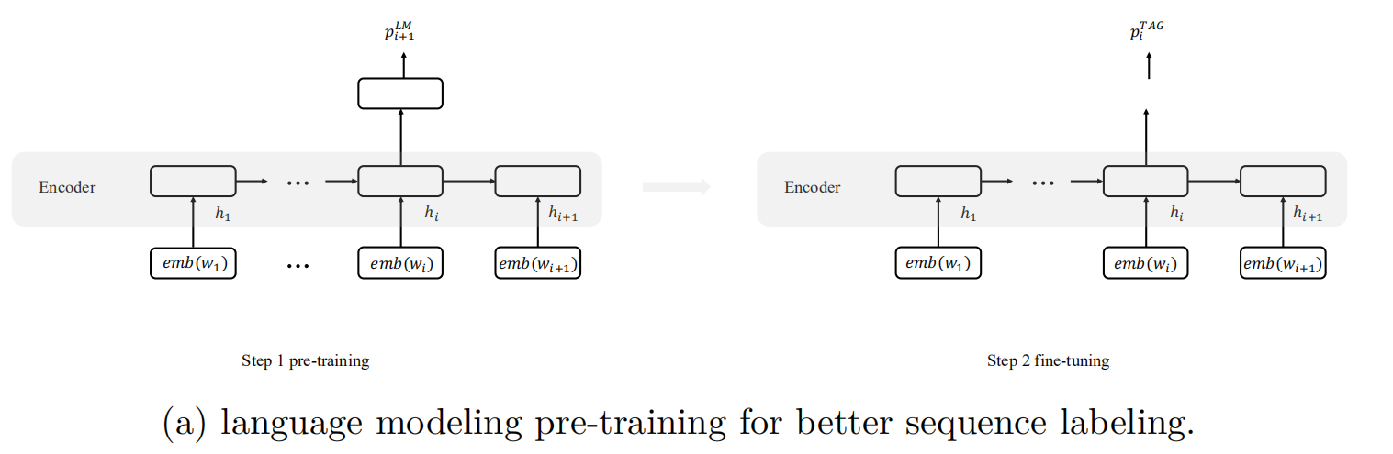
Multi-task Learning
Multi-task learning (MTL) exploits parameter sharing for seeking mutual benefits between tasks.
e.g
knowledge from language modeling is transferred to sequence labeling. knowledge for dependency arc structure and label merge into a parser (week 10).
[1] Rei M. (2017). Semi-supervised multitask learning for sequence labeling. ACL 2017.

Slide 4
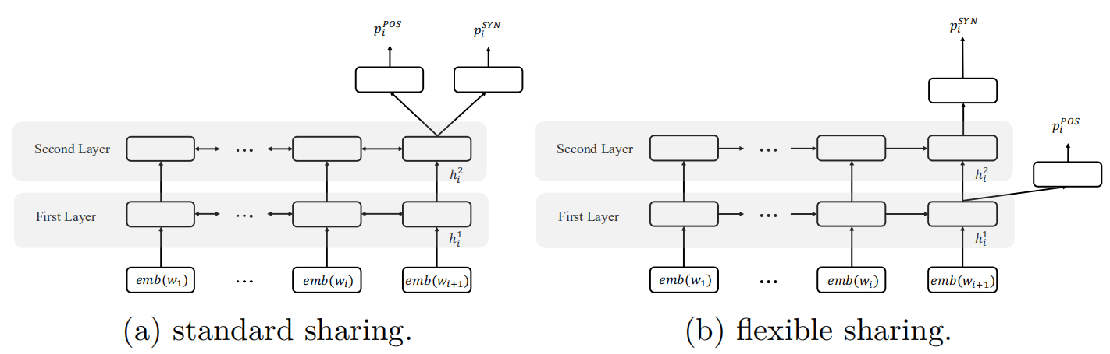
Selecting Parameters for Sharing
Selecting shared layers.
Different infomation can be encoded in different layers.
Sequence labeling benefits from more shallow contextual information, which is better captured in lower LSTM layers.
[1] Søgaard A, Goldberg Y. (2016). Deep multi-task learning with low level tasks supervised at lower layers. ACL 2016.

Slide 5
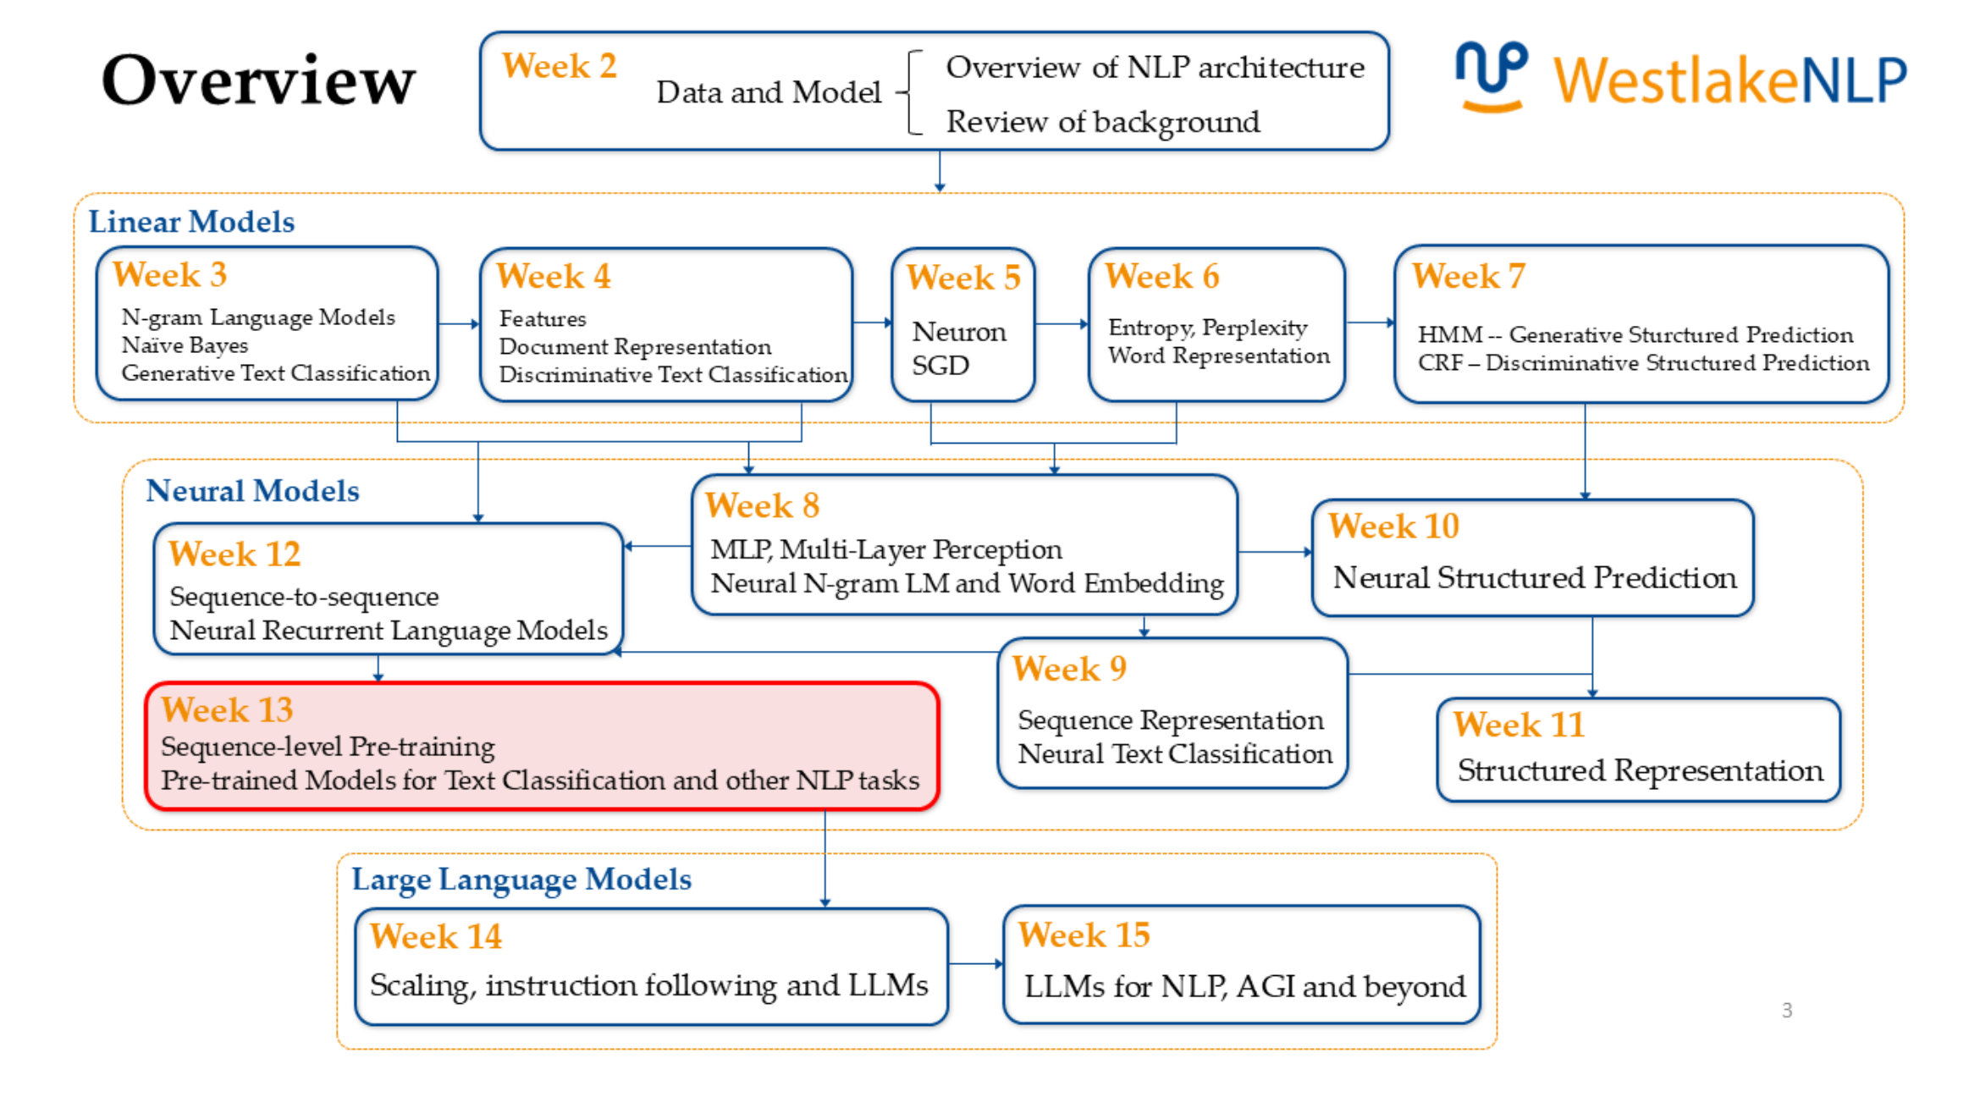


Slide 6
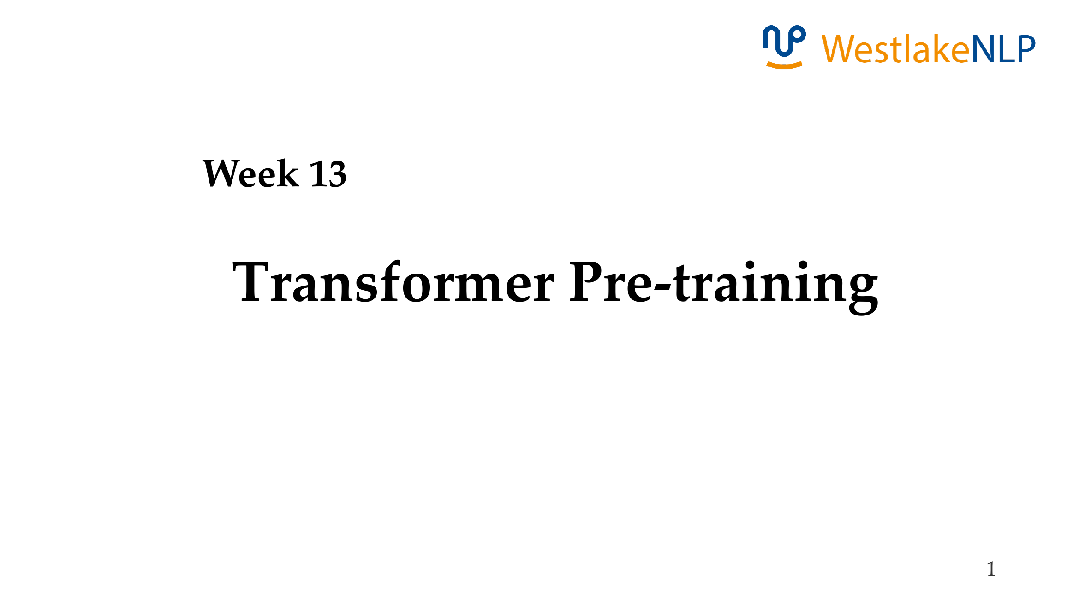

Slide 7

Content
13.1 Transformer Pre-training
13.1.1 GPT: Generative Pre-Training
13.1.2 BERT: Bidirectional Encoder Representations from Transformer
13.1.3 BART: Bidirectional and Auto-Regressive Transformer
13.2 Using Pre-trained Transformer for Solving NLP Tasks
13.2.1 Text Classification
13.2.2 Structured Prediction
13.2.3 Generation
13.3 Analyzing Pre-trained Models
13.3.1 Analyzing BERT
13.3.2 Knowledge in Pretrained LM
13.3.3 Language Models Take Shortcuts

Slide 8
Content
13.1 Transformer Pre-training
13.1.1 GPT: Generative Pre-Training
13.1.2 BERT: Bidirectional Encoder Representations from Transformer
13.1.3 BART: Bidirectional and Auto-Regressive Transformer
13.2 Using Pre-trained Transformer for Solving NLP Tasks
13.2.1 Text Classification
13.2.2 Structured Prediction
13.2.3 Generation
13.3 Analyzing Pre-trained Models
13.3.1 Analyzing BERT
13.3.2 Knowledge in Pretrained LM
13.3.3 Language Models Take Shortcuts

Slide 9
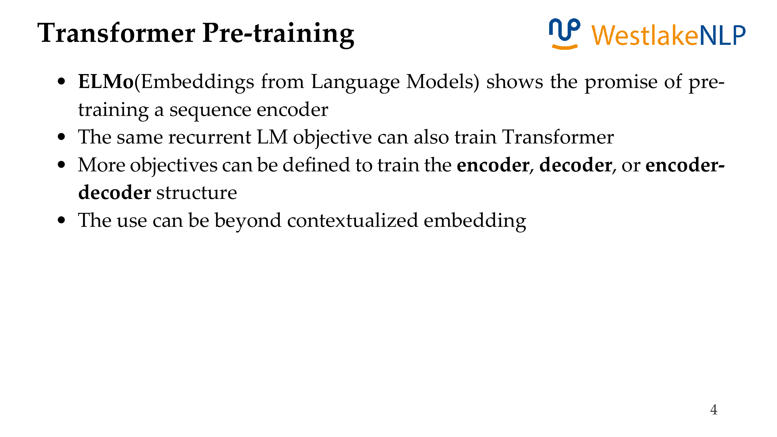

Slide 10
Content
13.1 Transformer Pre-training
13.1.1 GPT: Generative Pre-Training
13.1.2 BERT: Bidirectional Encoder Representations from Transformer
13.1.3 BART: Bidirectional and Auto-Regressive Transformer
13.2 Using Pre-trained Transformer for Solving NLP Tasks
13.2.1 Text Classification
13.2.2 Structured Prediction
13.2.3 Generation
13.3 Analyzing Pre-trained Models
13.3.1 Analyzing BERT
13.3.2 Knowledge in Pretrained LM
13.3.3 Language Models Take Shortcuts

Slide 11
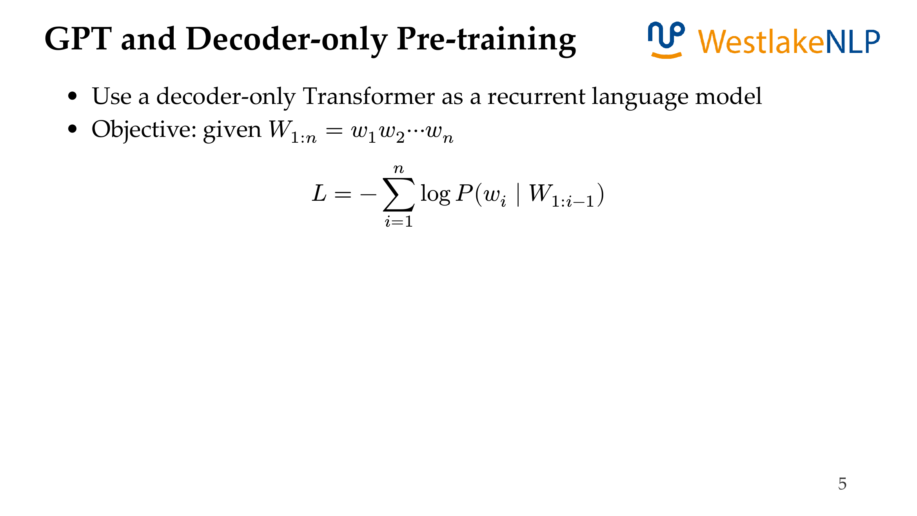

GPT: Generative Pre-Training

Slide 12
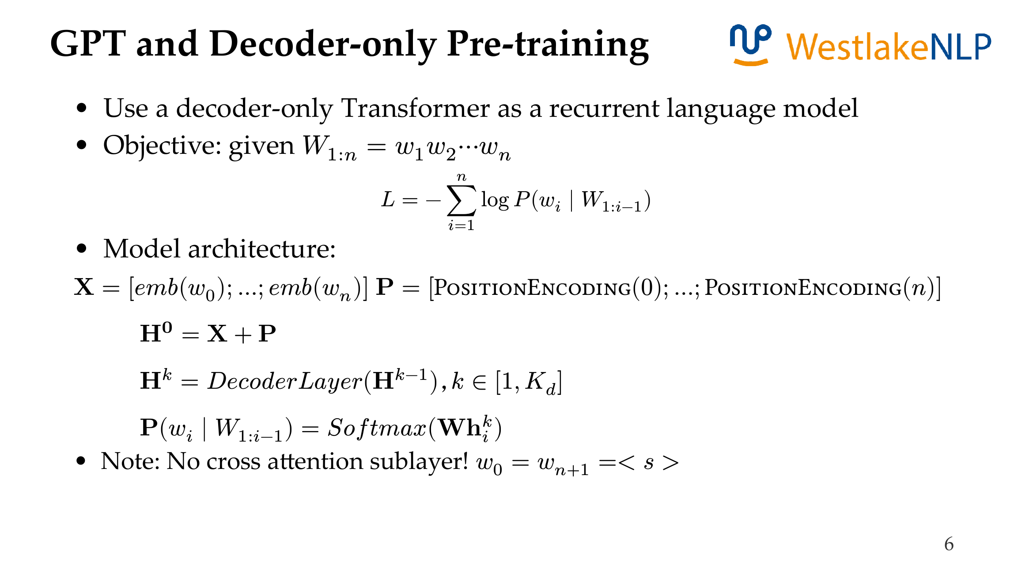
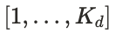
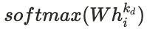
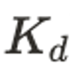
GPT: Generative Pre-Training

Slide 13

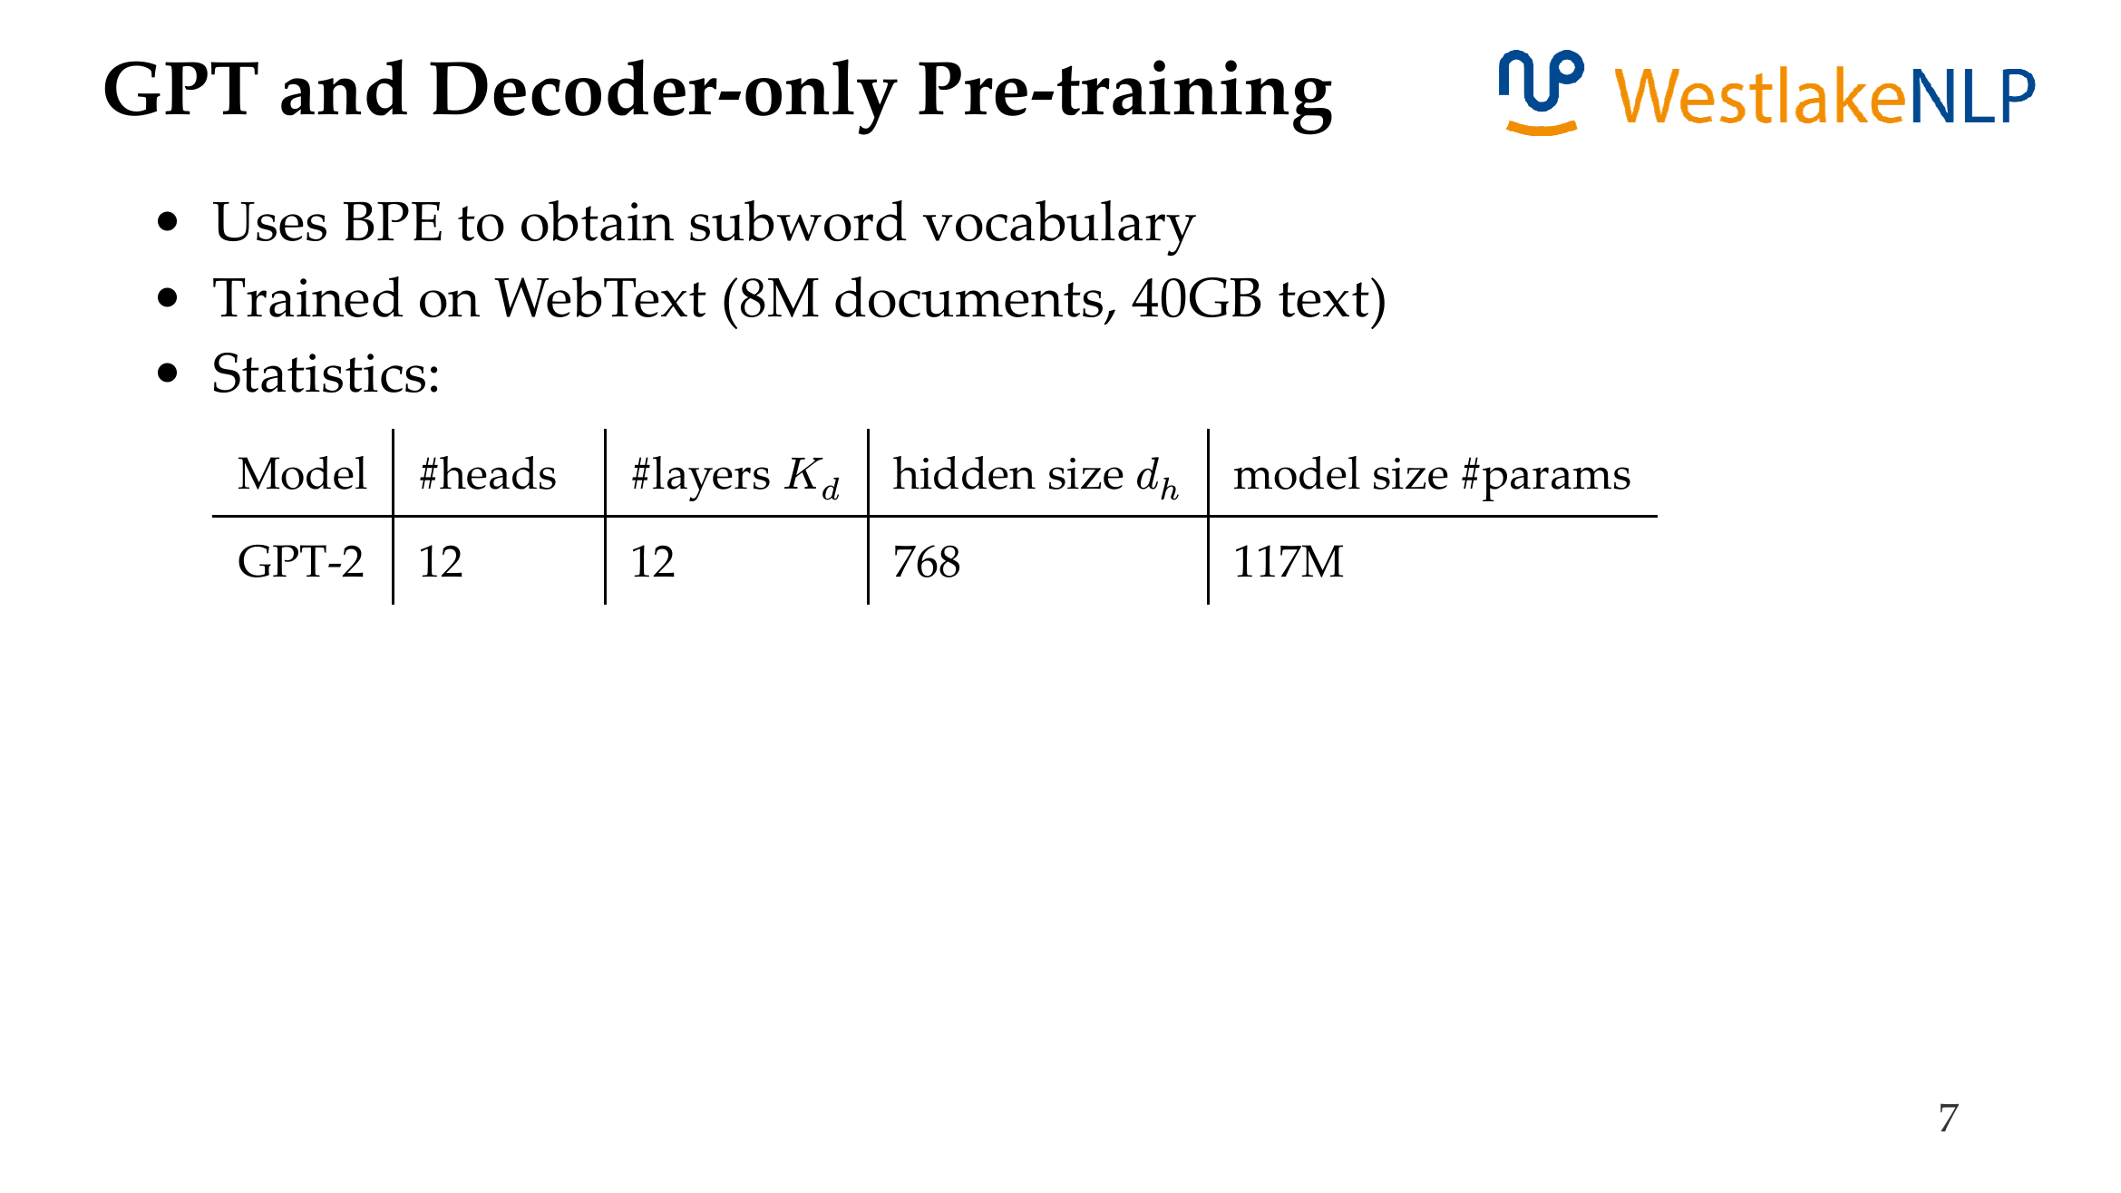
GPT: Generative Pre-Training
GPT 1

Slide 14
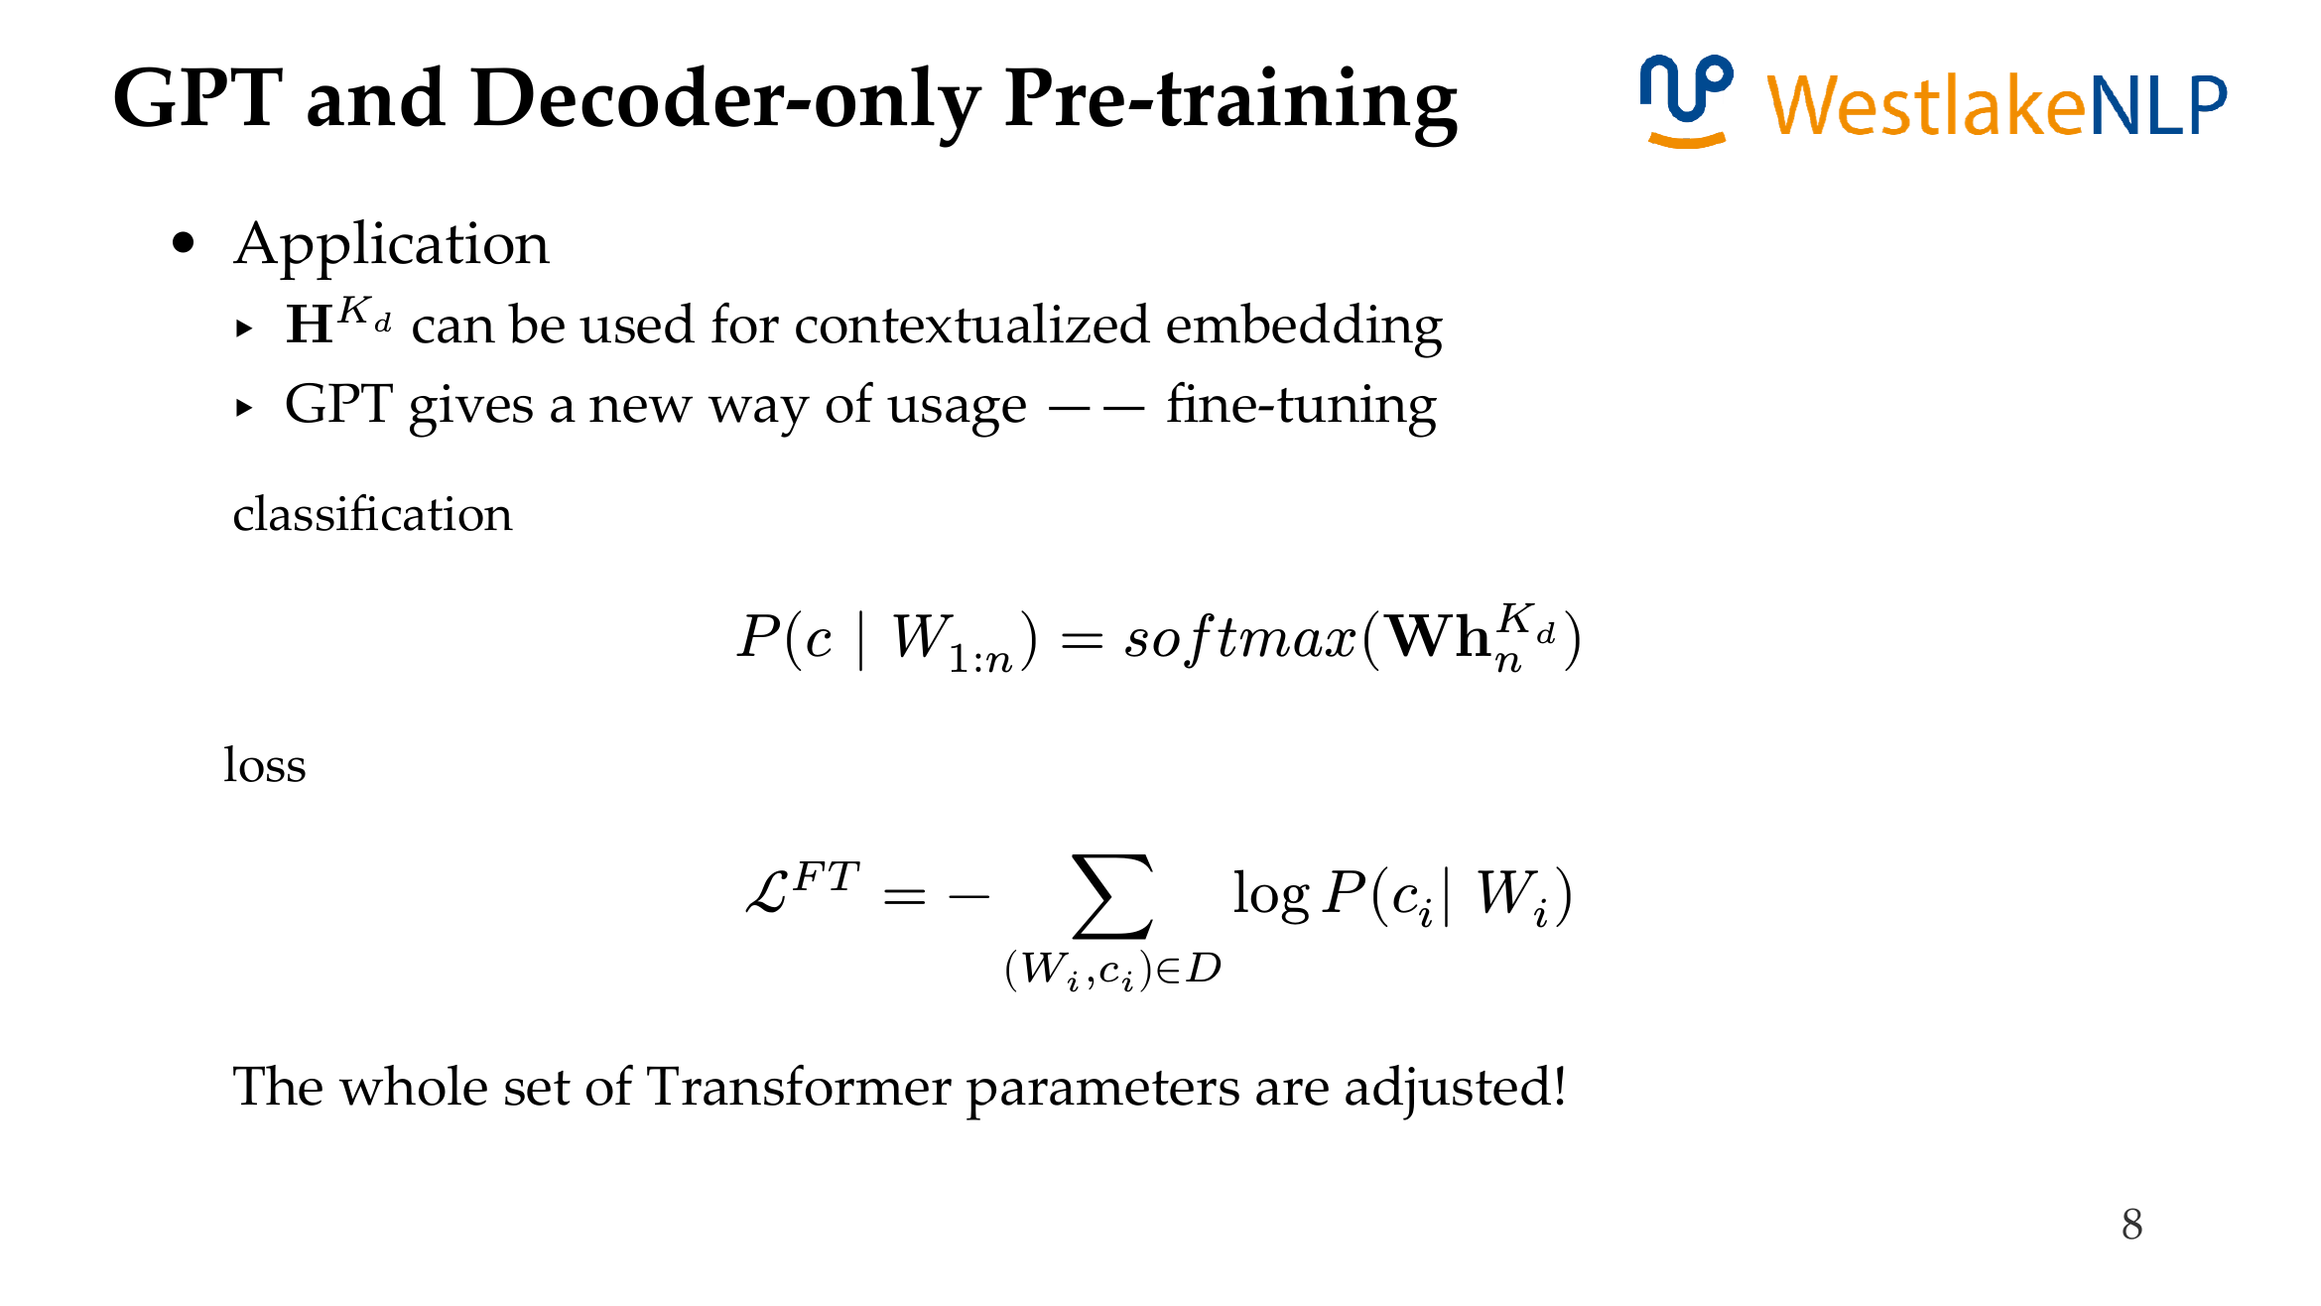
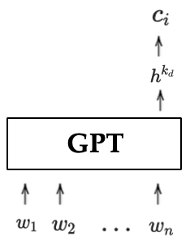
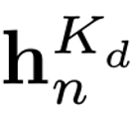
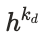
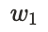
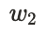

GPT: Generative Pre-Training
GPT
GPT encoder only uni-directional information.

Slide 15
Content
13.1 Transformer Pre-training
13.1.1 GPT: Generative Pre-Training
13.1.2 BERT: Bidirectional Encoder Representations from Transformer
13.1.3 BART: Bidirectional and Auto-Regressive Transformer
13.2 Using Pre-trained Transformer for Solving NLP Tasks
13.2.1 Text Classification
13.2.2 Structured Prediction
13.2.3 Generation
13.3 Analyzing Pre-trained Models
13.3.1 Analyzing BERT
13.3.2 Knowledge in Pretrained LM
13.3.3 Language Models Take Shortcuts

Slide 16
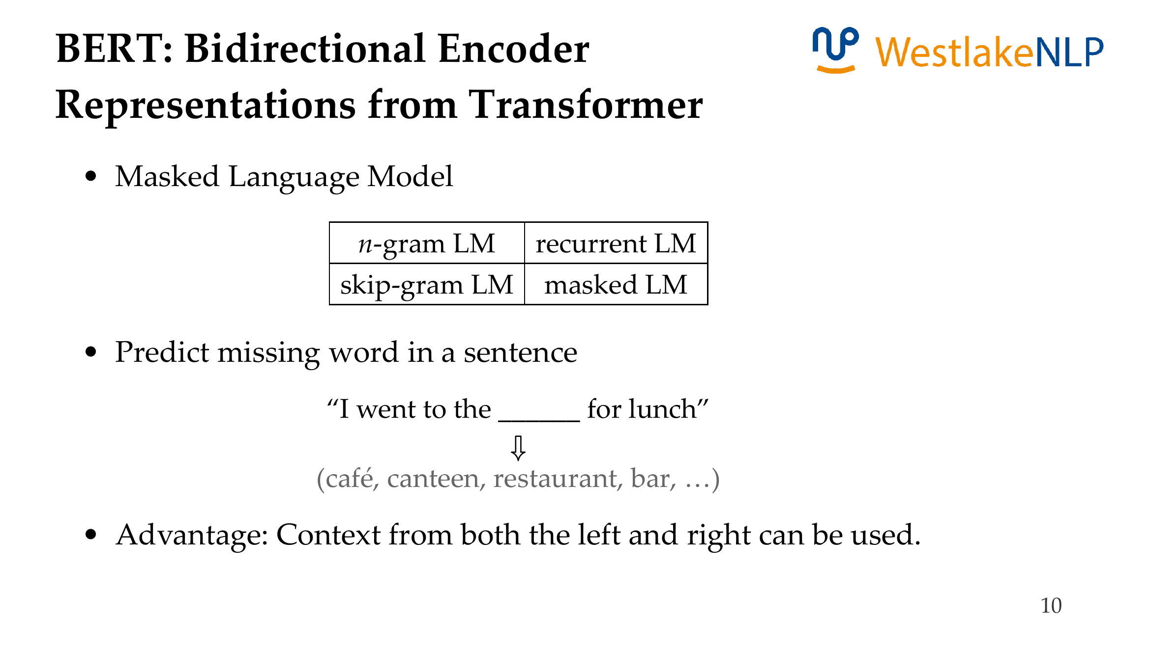

Slide 17
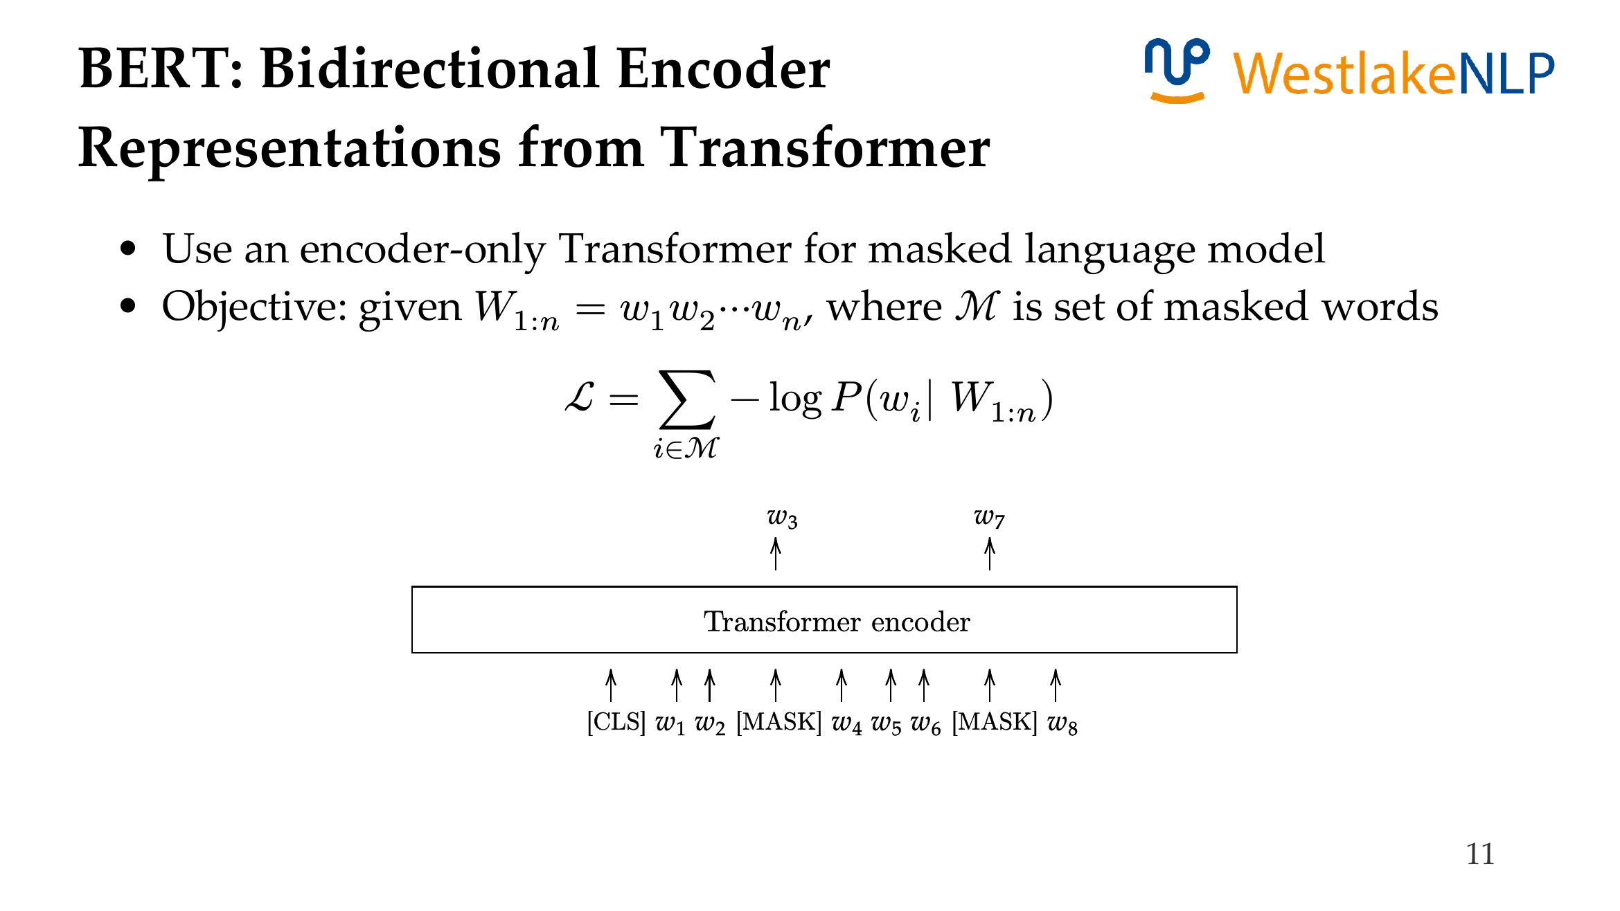

Slide 18
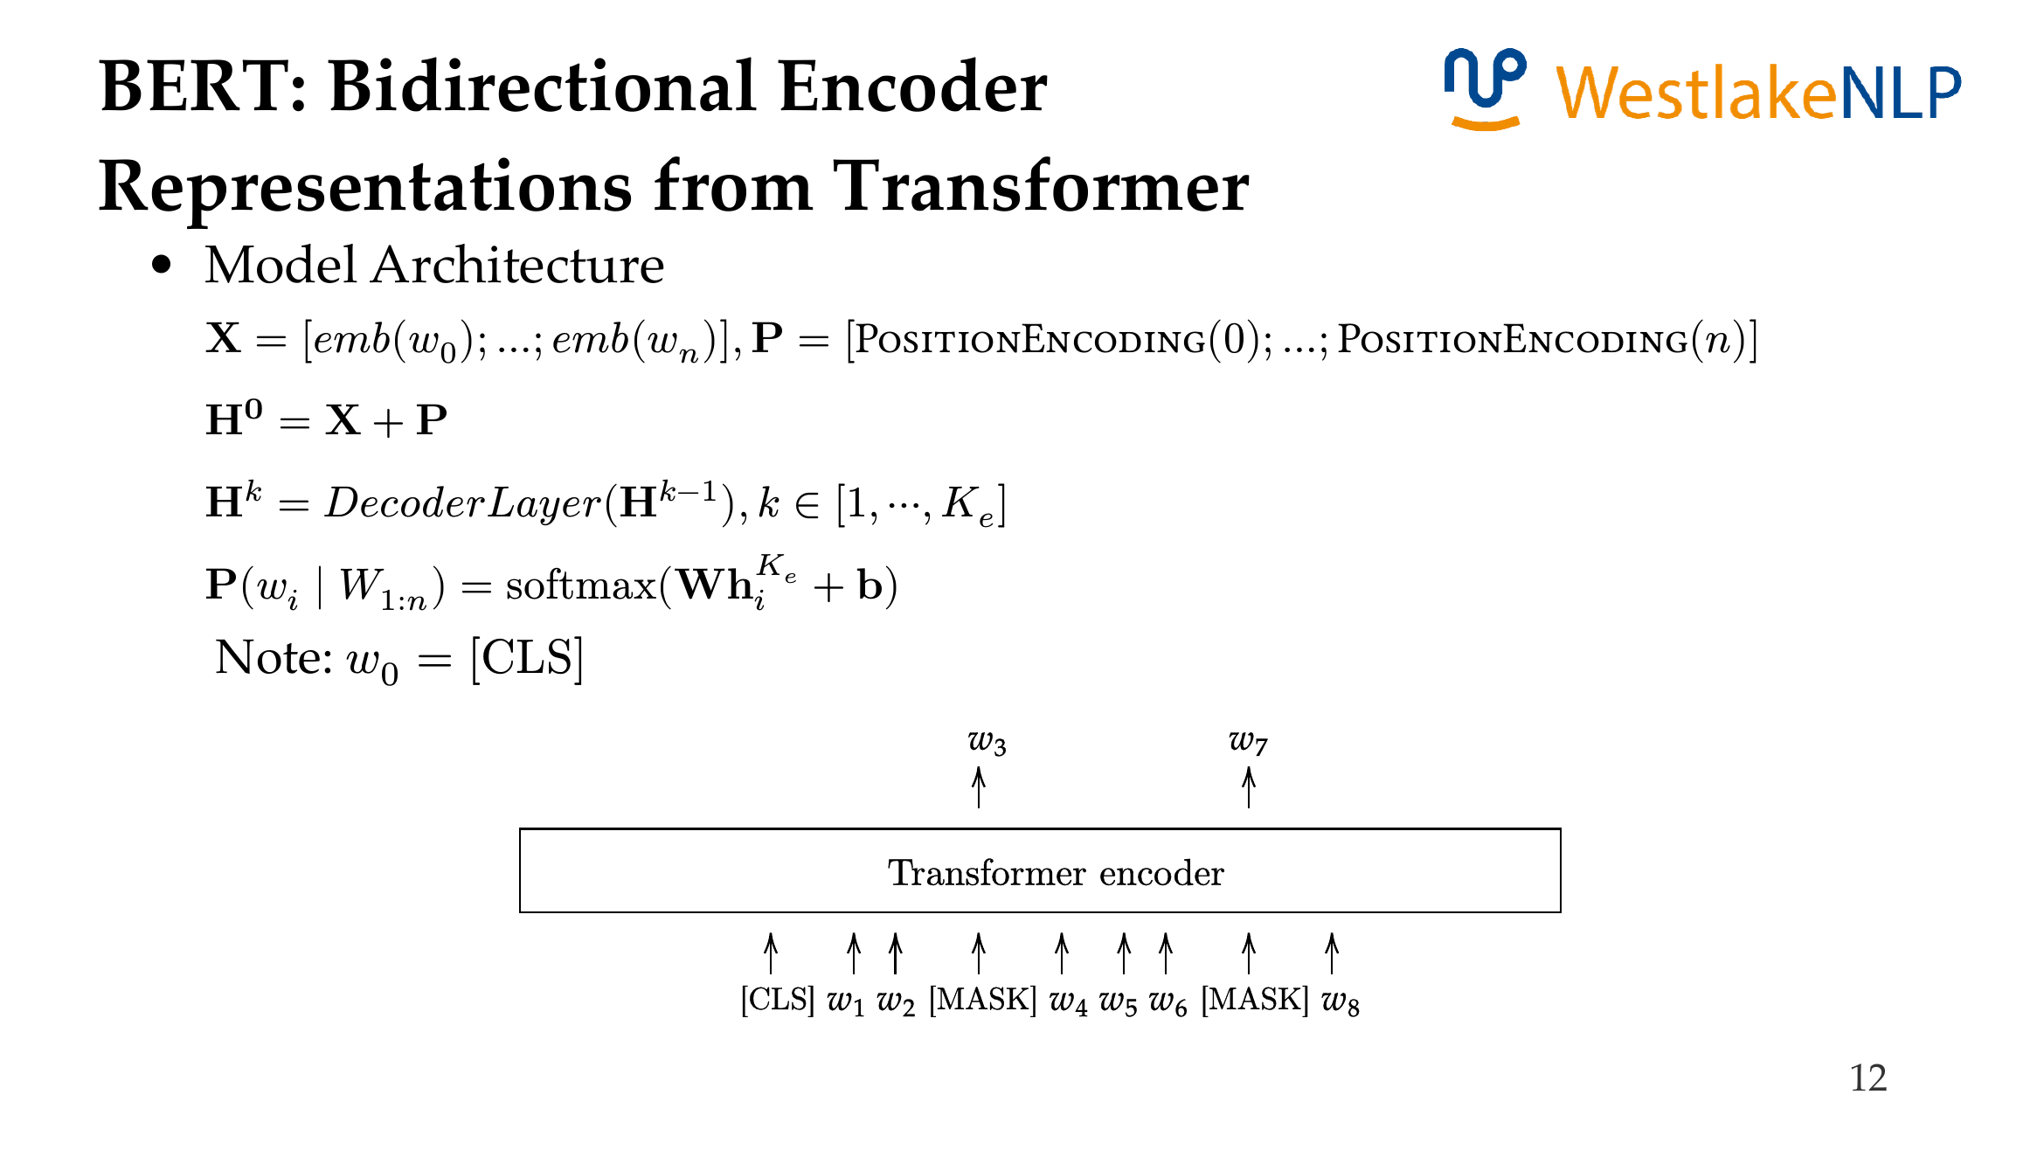
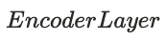


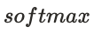

Slide 19
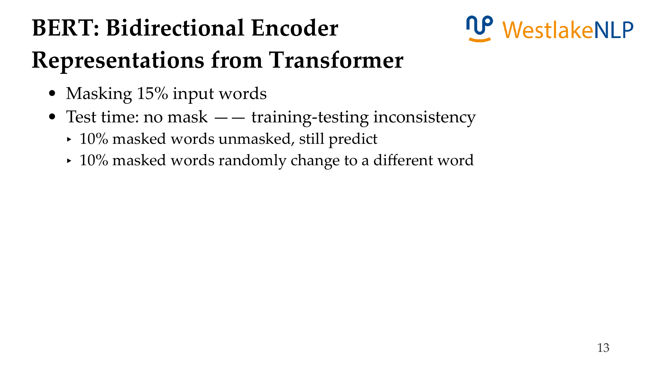
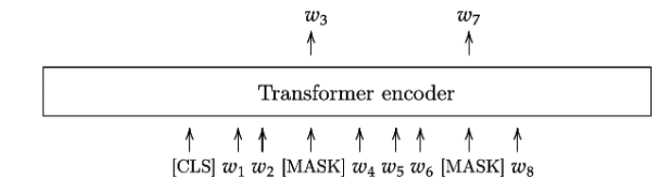
(to avoid just copying unmasked words)

Slide 20
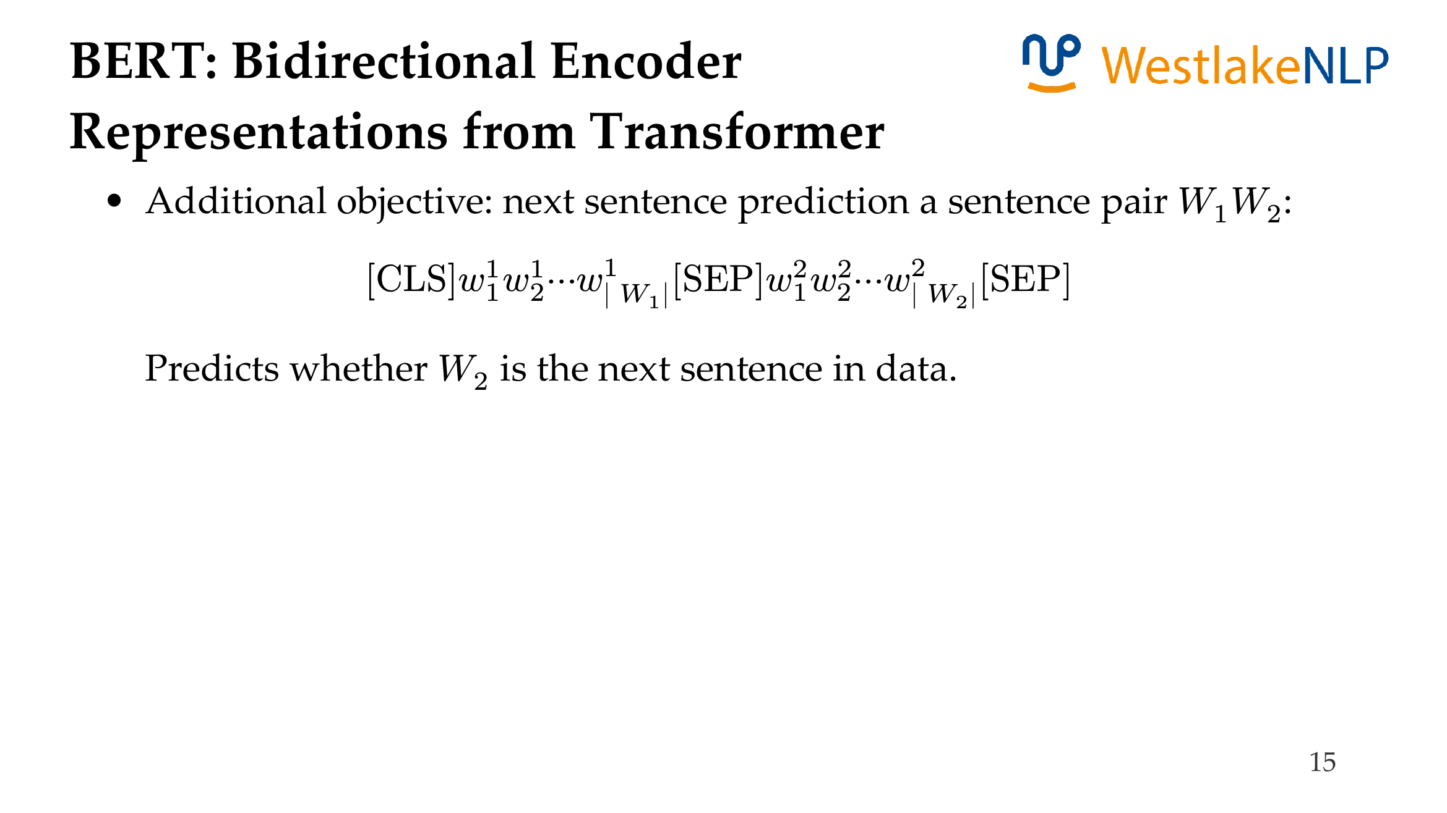
Negative positive sample rate 1:1.

Slide 21
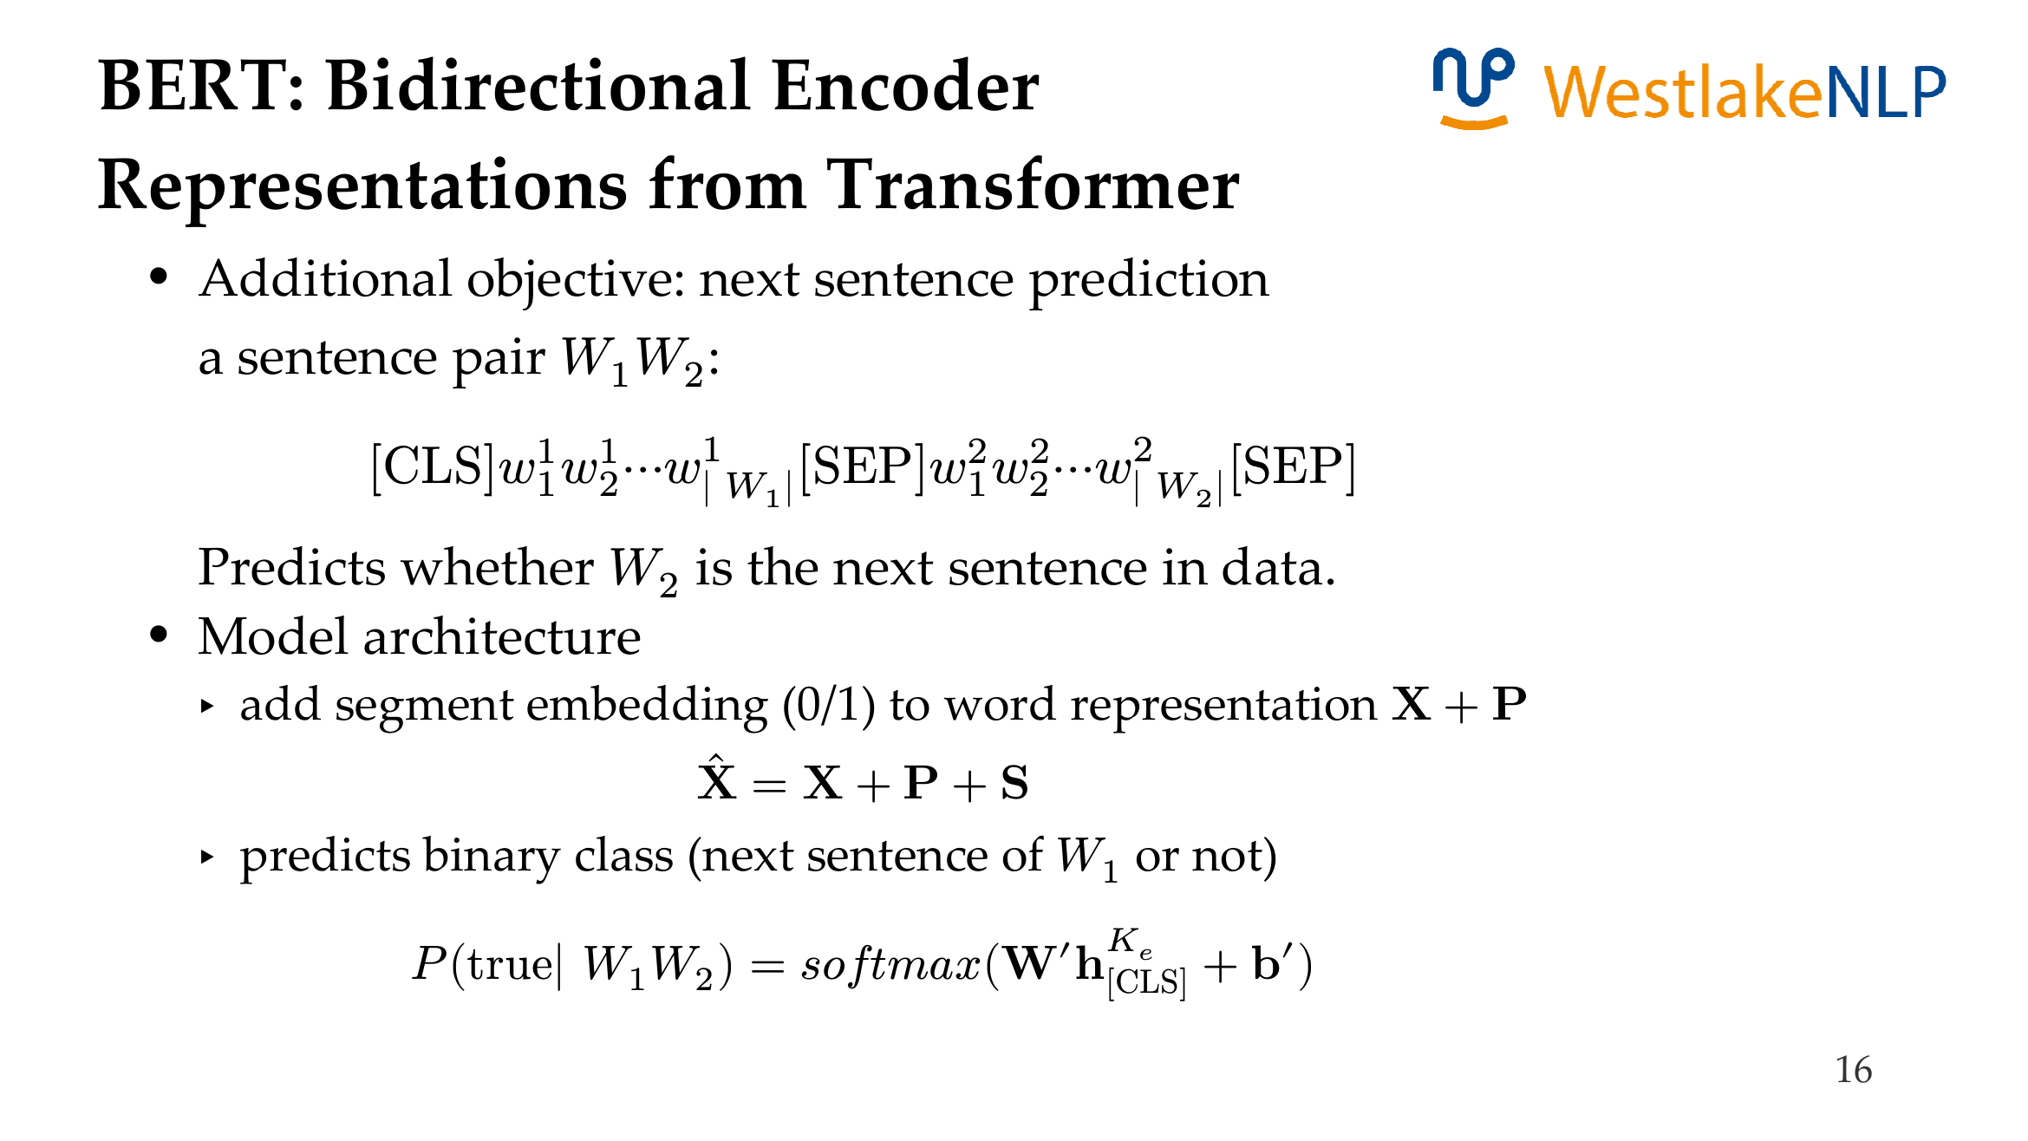

Slide 22
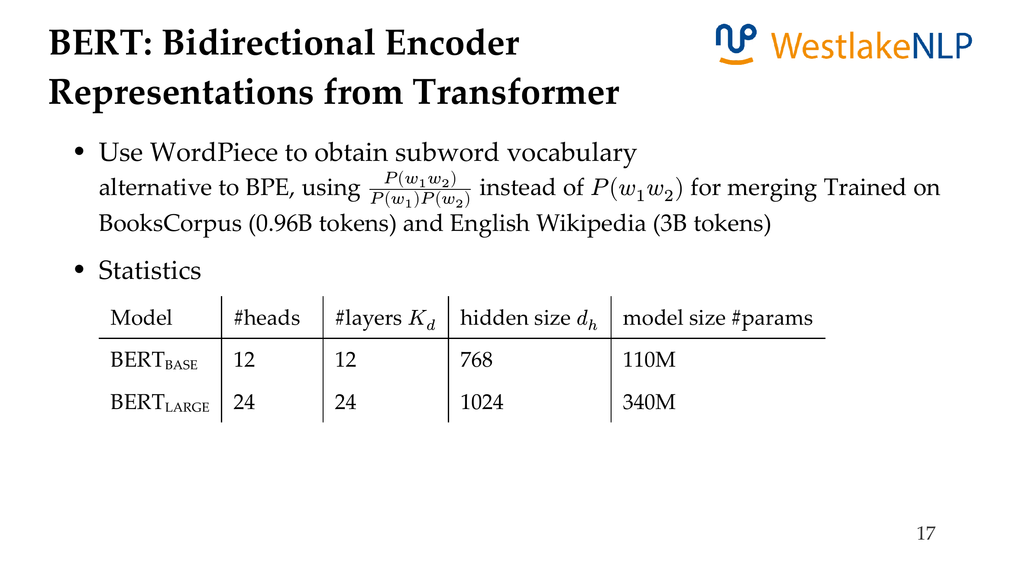


,full detail private to Google,

Slide 23
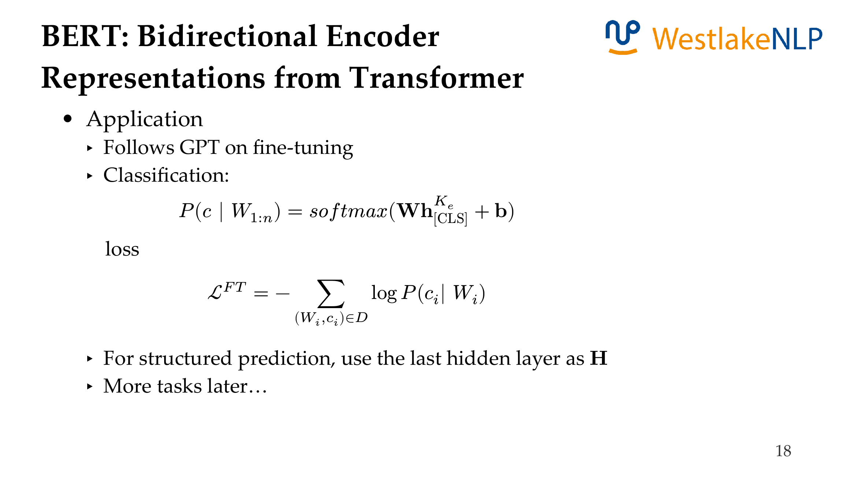
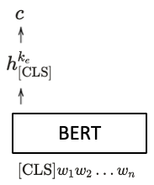

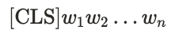
BERT

Slide 24
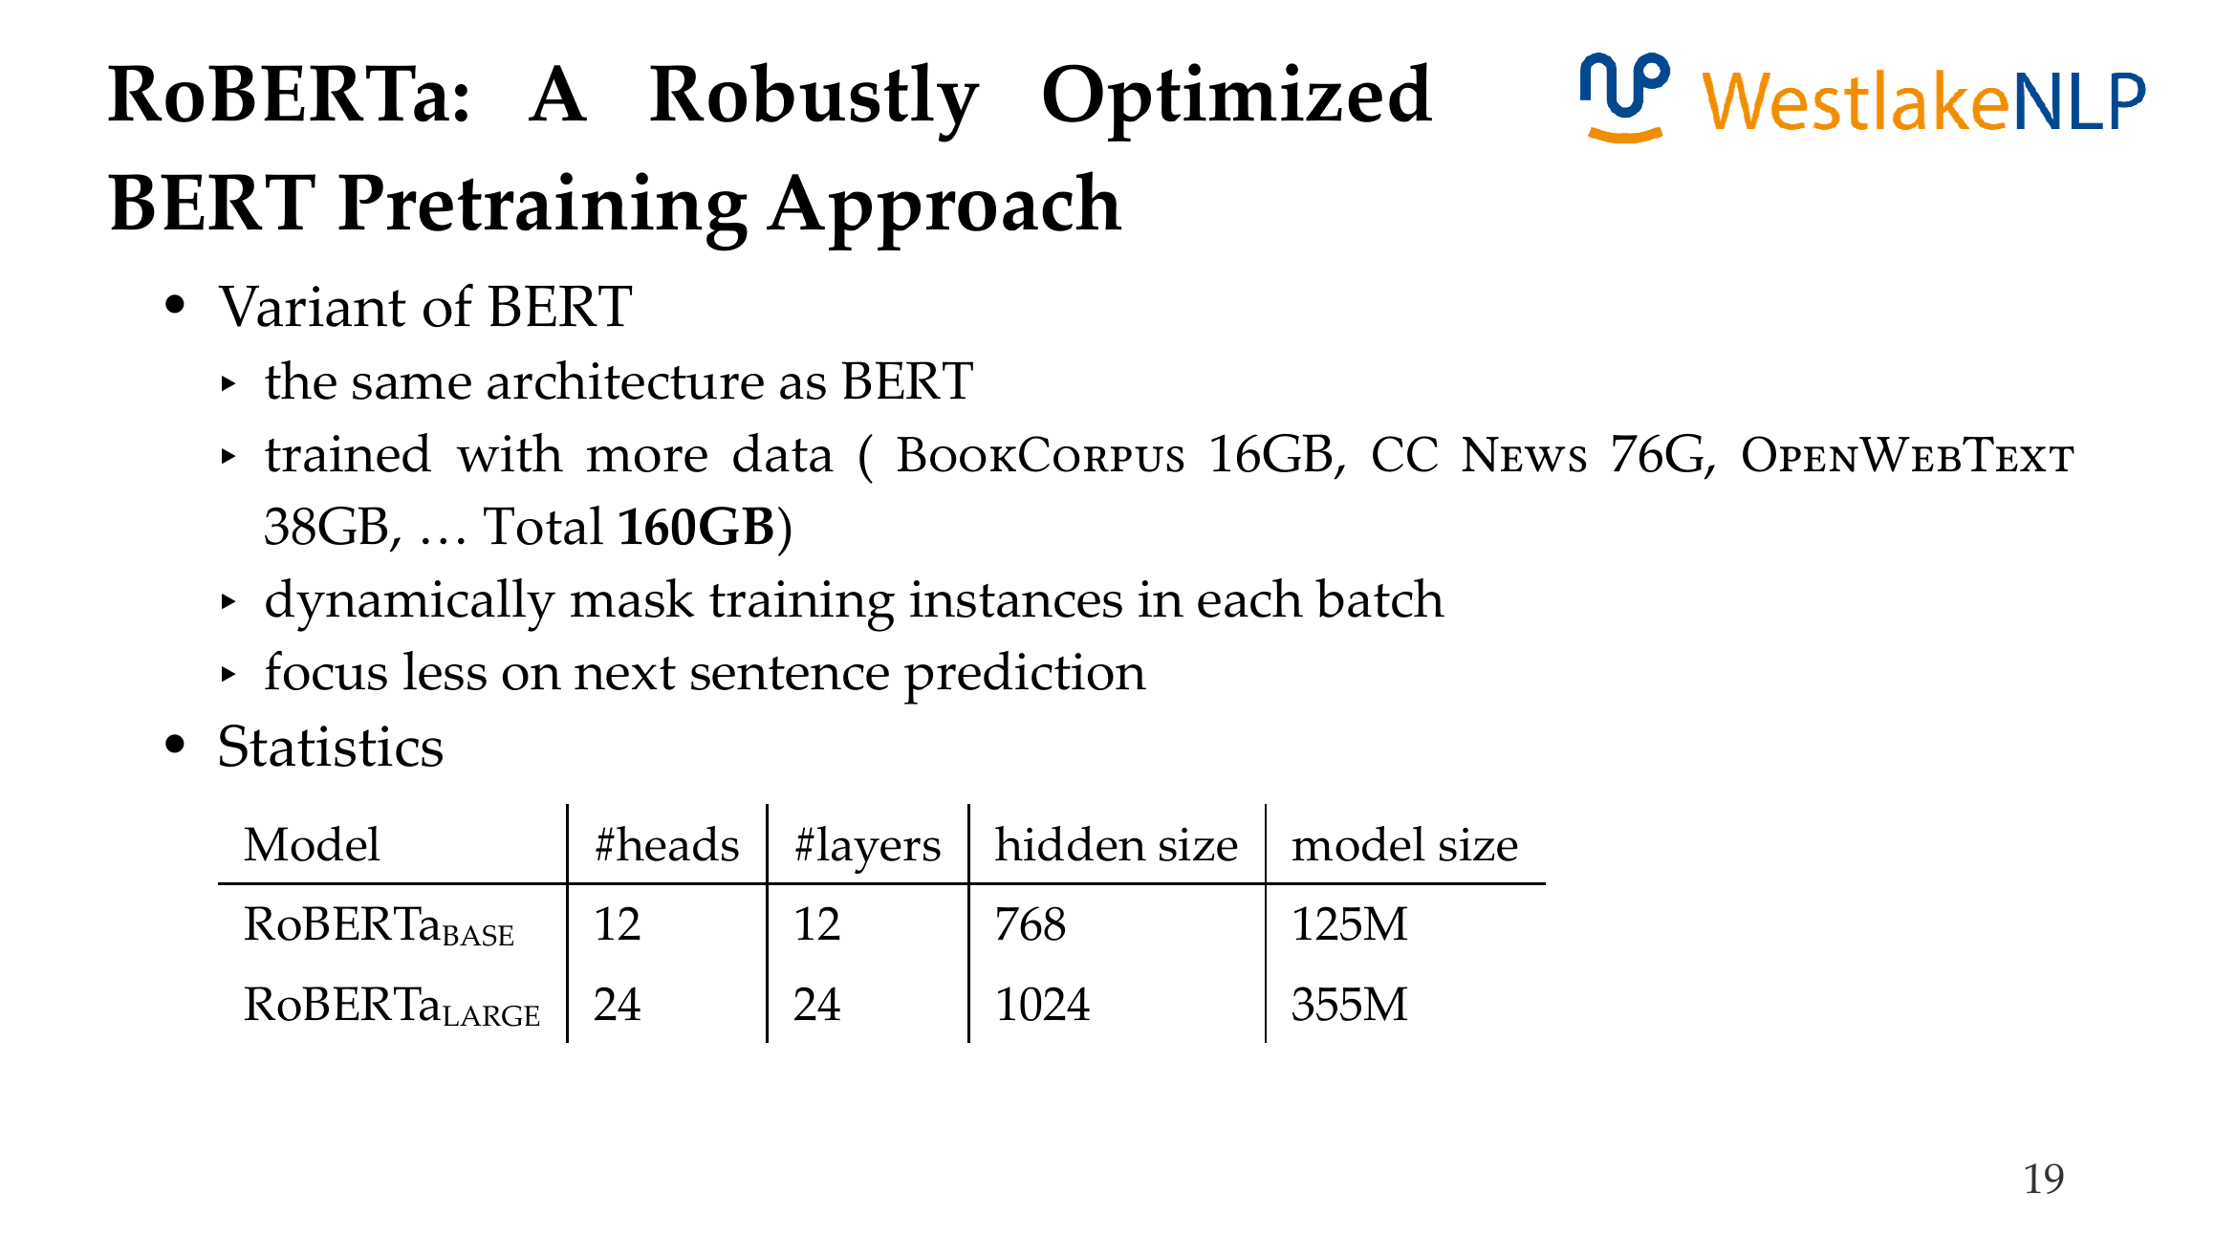
, and more training epochs.
does not consider next sentence prediction

Slide 25
Content
13.1 Transformer Pre-training
13.1.1 GPT: Generative Pre-Training
13.1.2 BERT: Bidirectional Encoder Representations from Transformer
13.1.3 BART: Bidirectional and Auto-Regressive Transformer
13.2 Using Pre-trained Transformer for Solving NLP Tasks
13.2.1 Text Classification
13.2.2 Structured Prediction
13.2.3 Generation
13.3 Analyzing Pre-trained Models
13.3.1 Analyzing BERT
13.3.2 Knowledge in Pretrained LM
13.3.3 Language Models Take Shortcuts

Slide 26
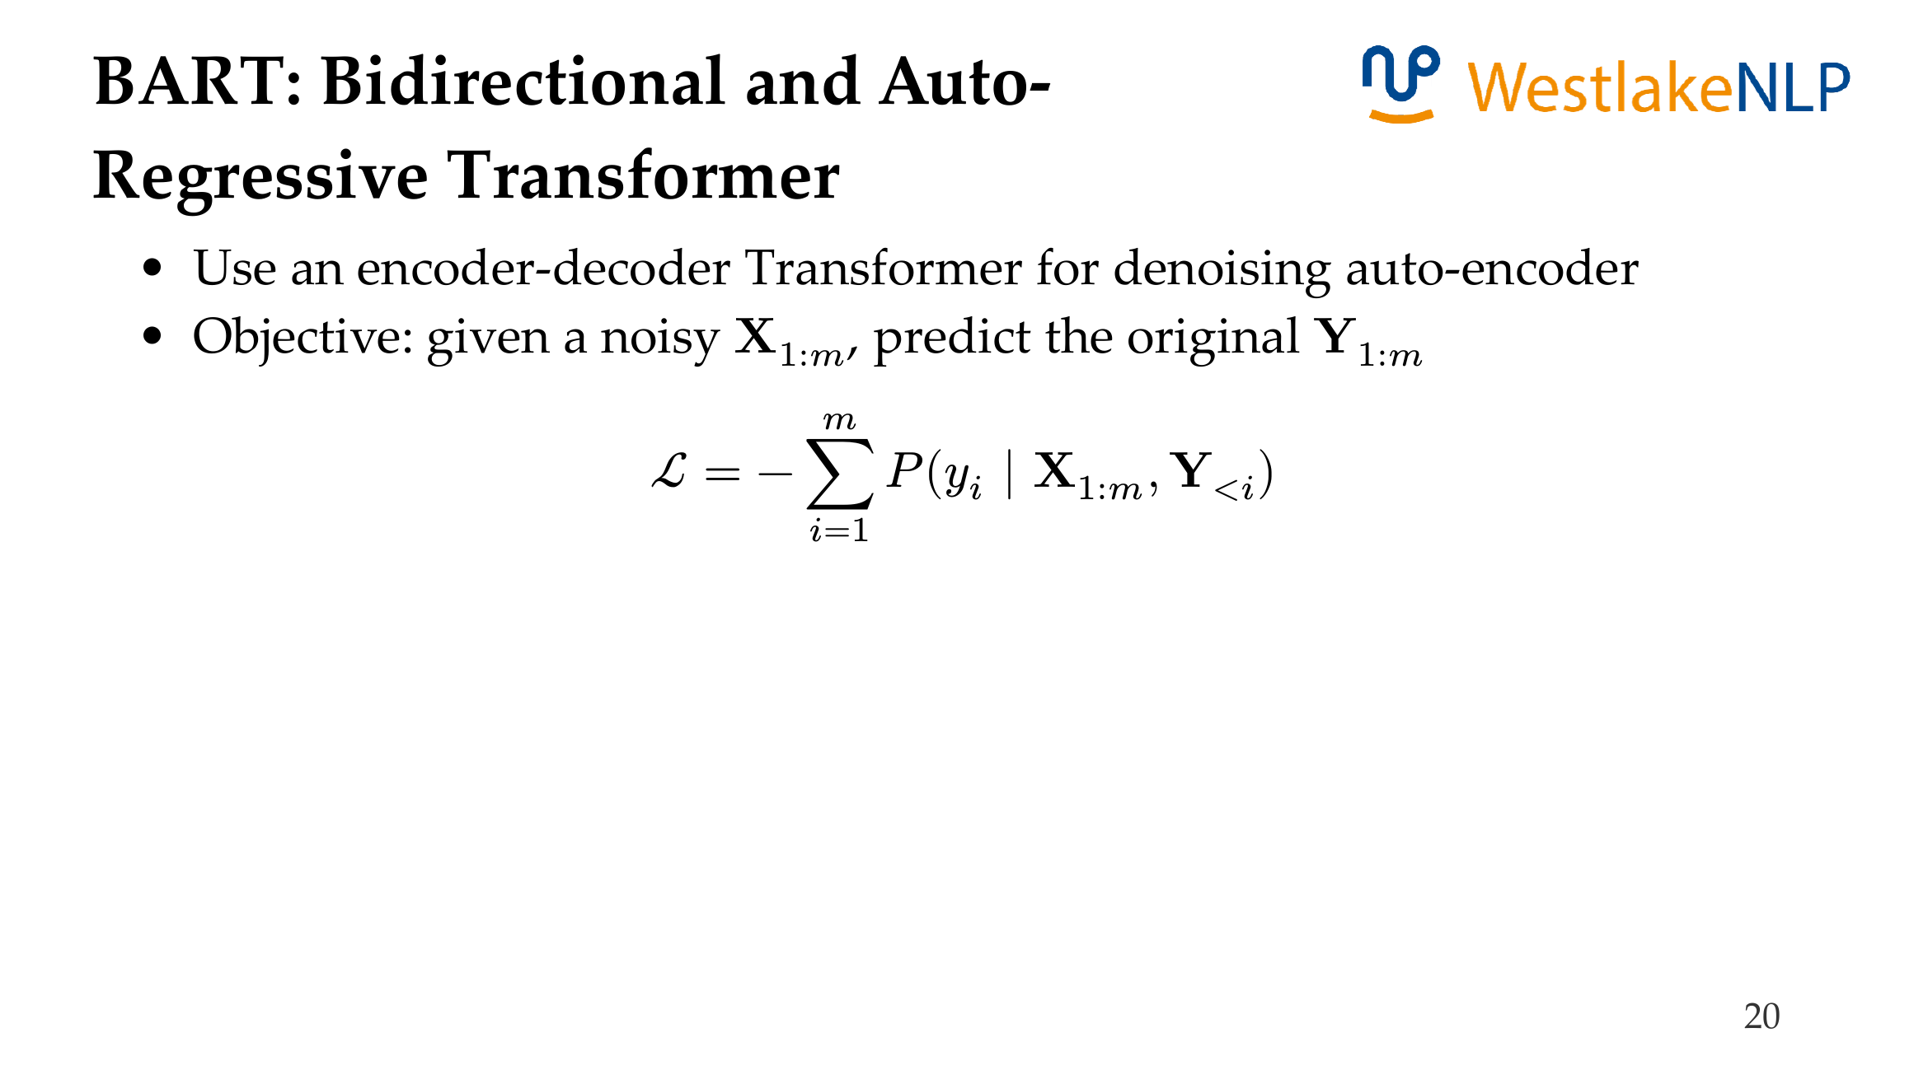
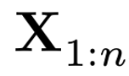
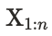
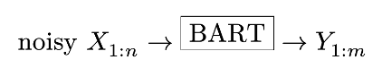

Slide 27
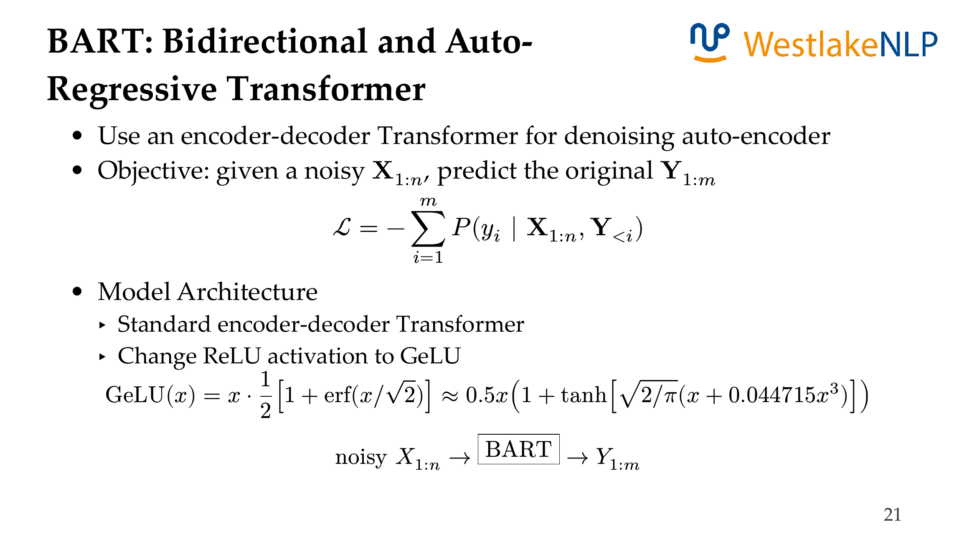

Slide 28
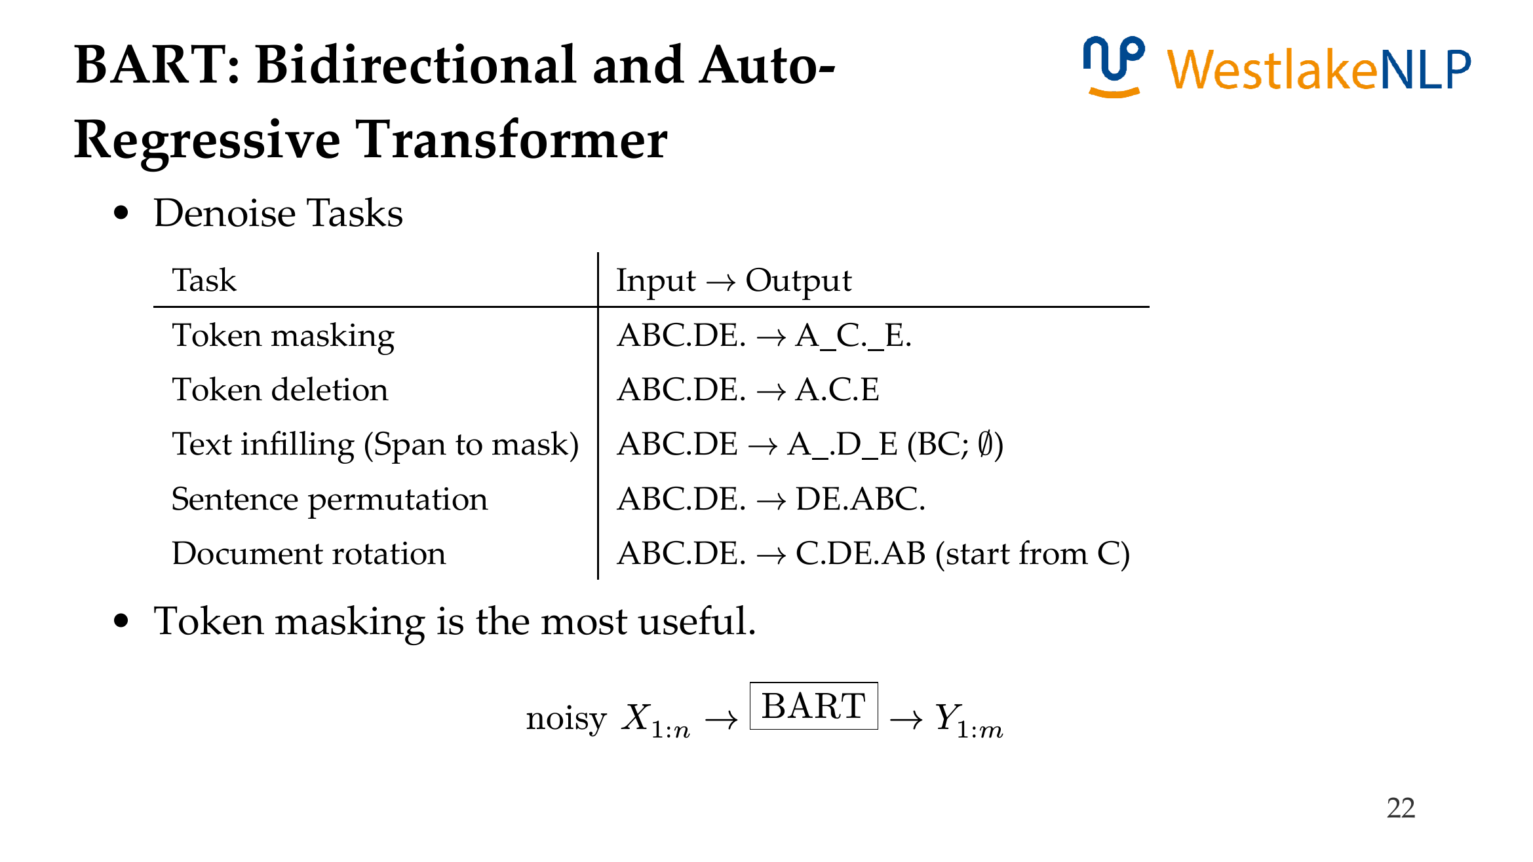
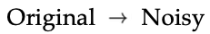

Slide 29
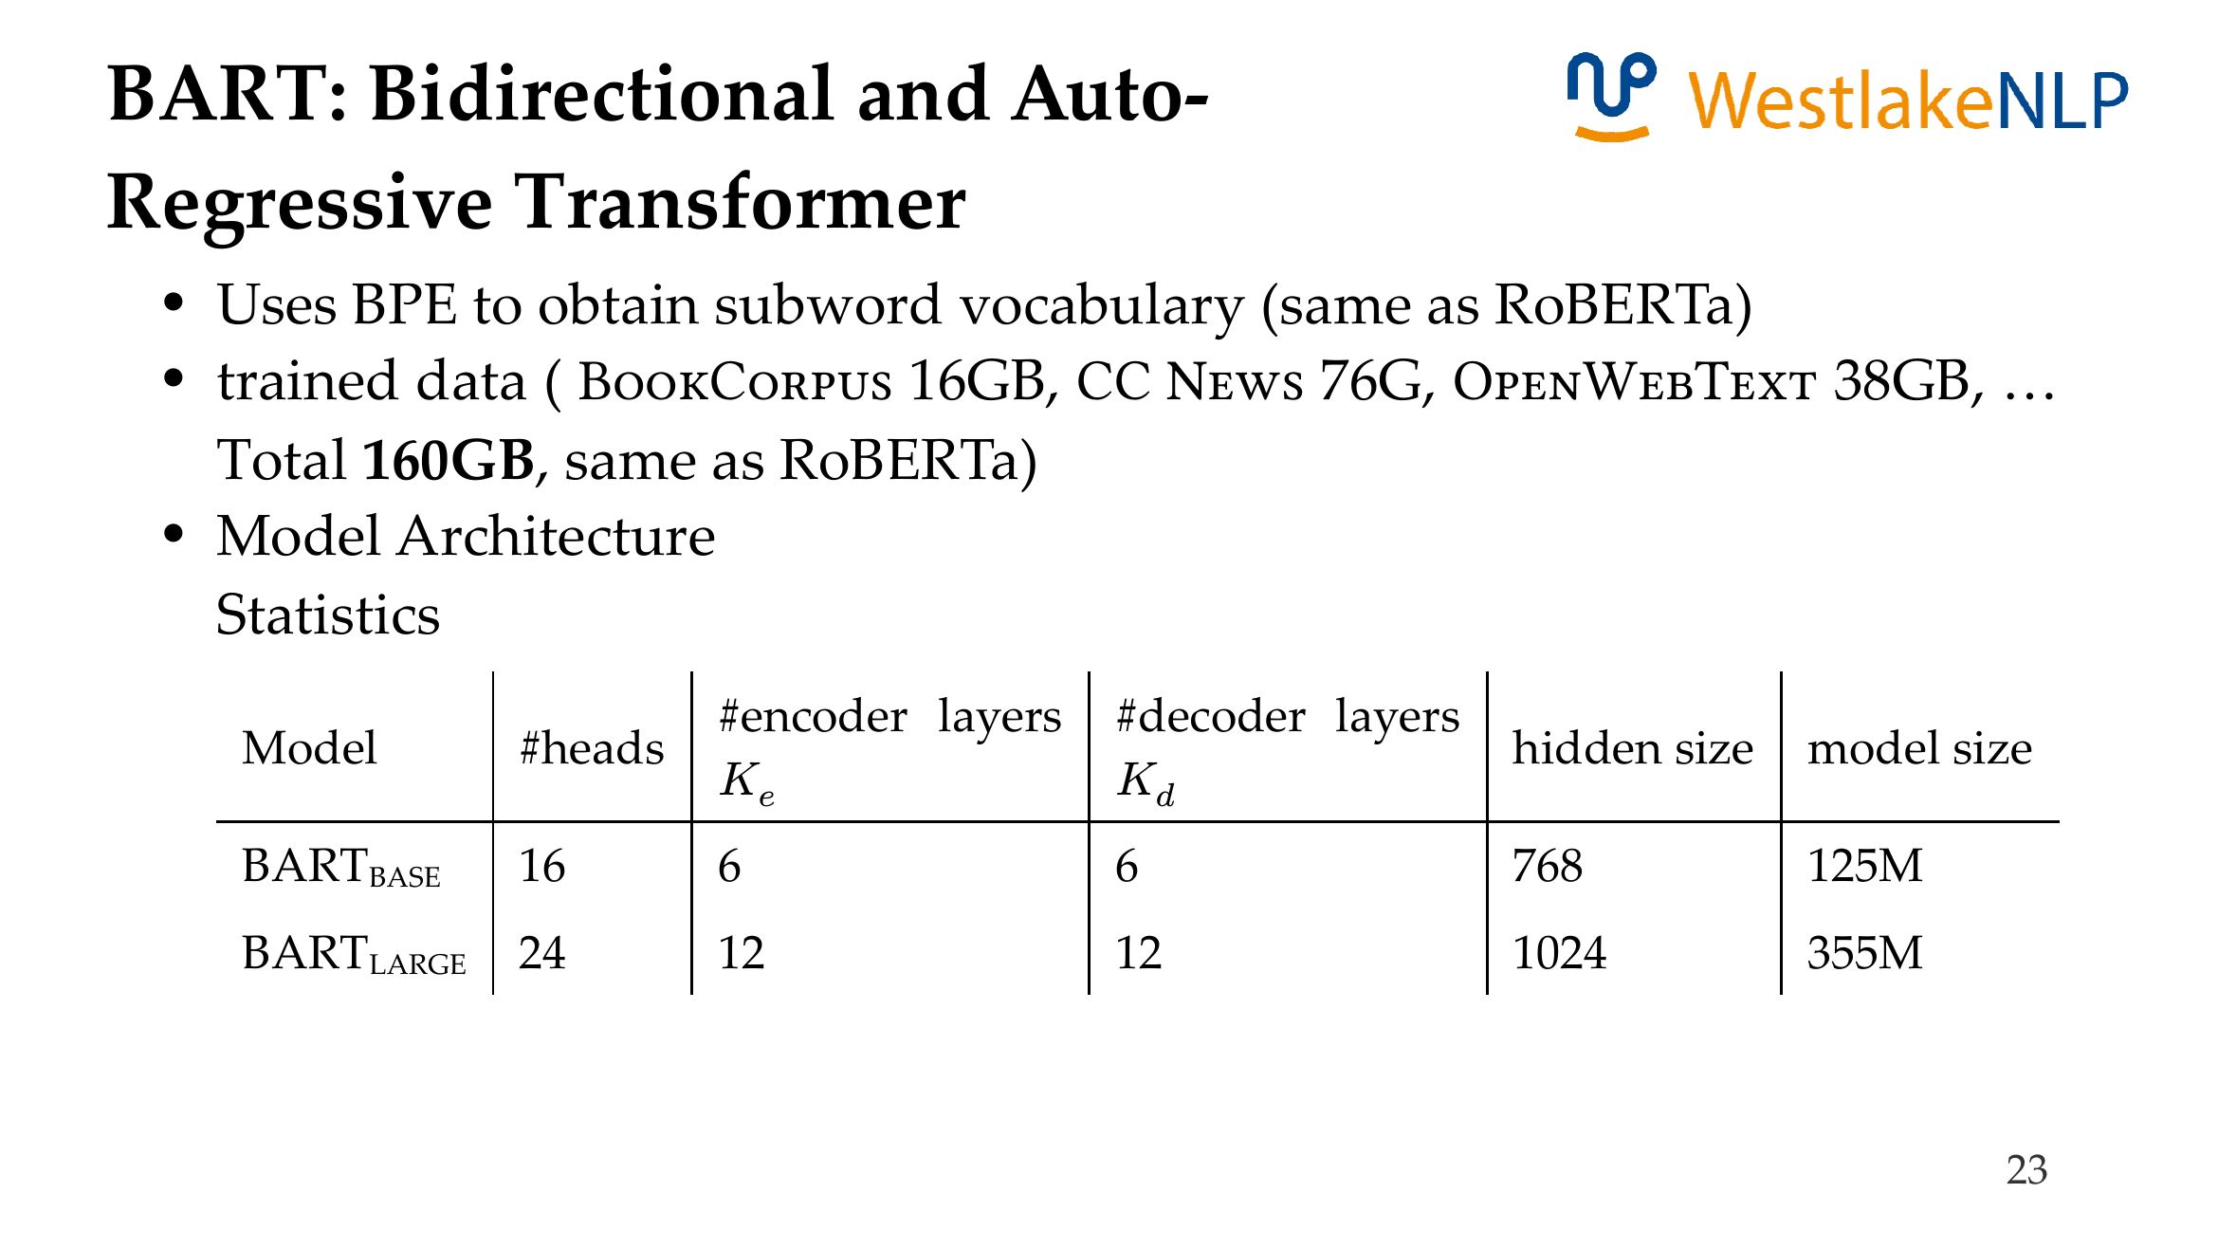

Slide 30
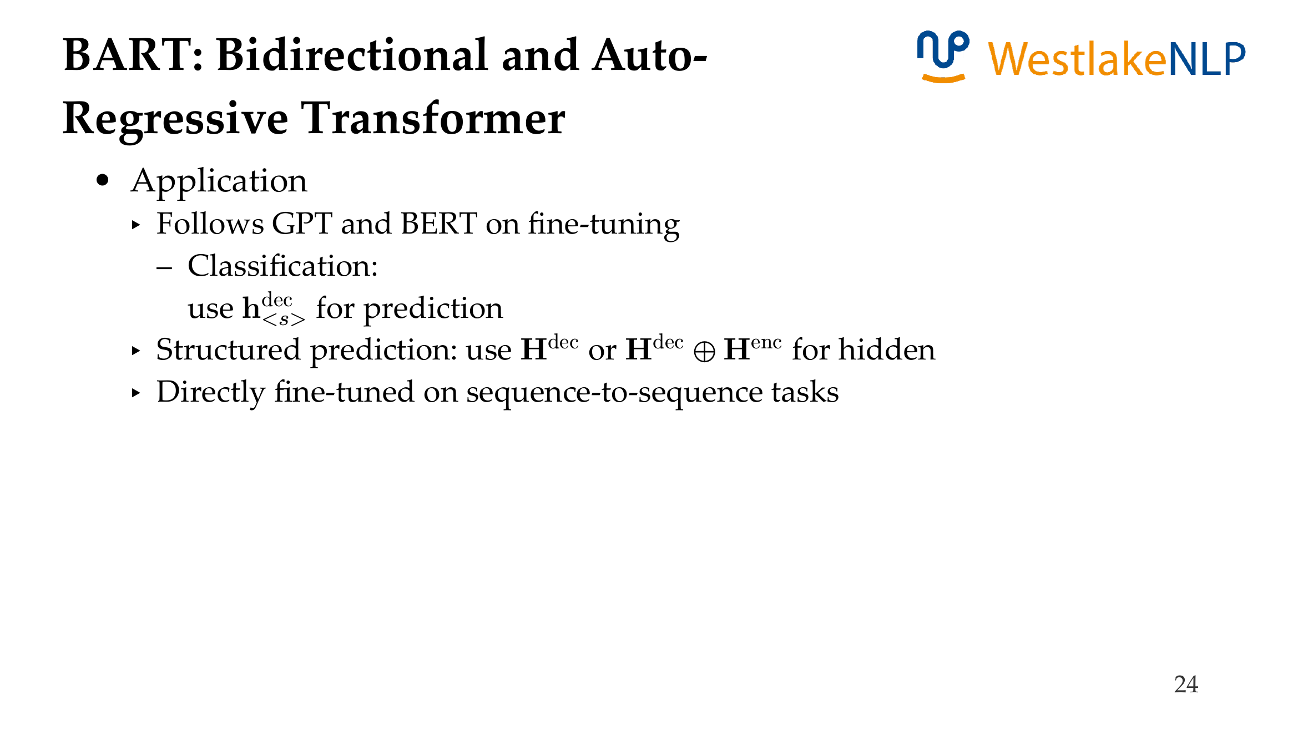
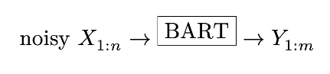

Slide 31
Content
13.1 Transformer Pre-training
13.1.1 GPT: Generative Pre-Training
13.1.2 BERT: Bidirectional Encoder Representations from Transformer
13.1.3 BART: Bidirectional and Auto-Regressive Transformer
13.2 Using Pre-trained Transformer for Solving NLP Tasks
13.2.1 Text Classification
13.2.2 Structured Prediction
13.2.3 Generation
13.3 Analyzing Pre-trained Models
13.3.1 Analyzing BERT
13.3.2 Knowledge in Pretrained LM
13.3.3 Language Models Take Shortcuts

Slide 32
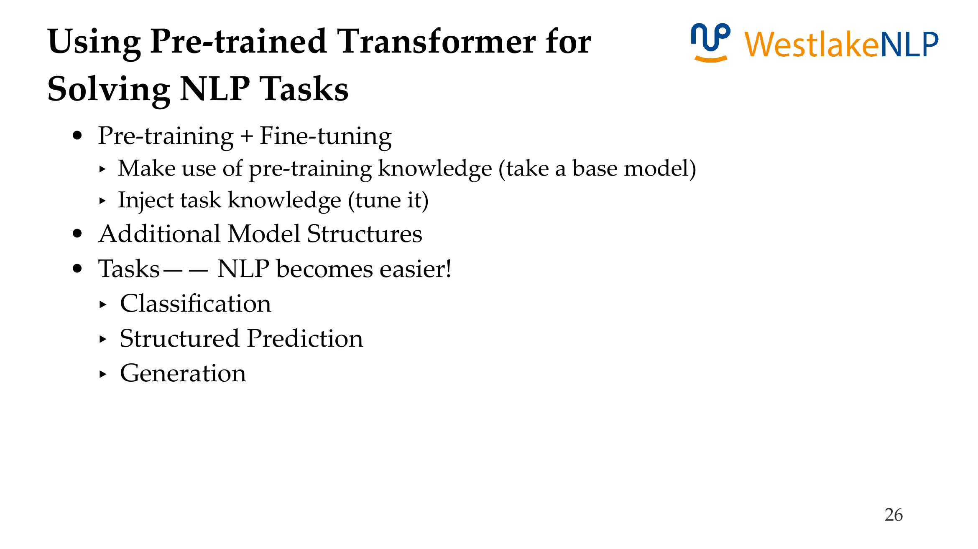

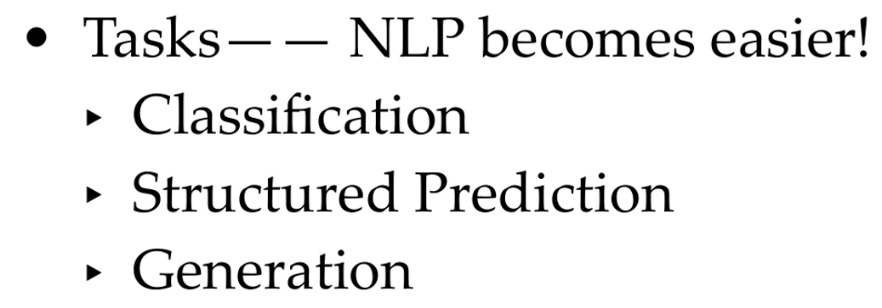

More techniques on how to tune LMs.

Slide 33
Content
13.1 Transformer Pre-training
13.1.1 GPT: Generative Pre-Training
13.1.2 BERT: Bidirectional Encoder Representations from Transformer
13.1.3 BART: Bidirectional and Auto-Regressive Transformer
13.2 Using Pre-trained Transformer for Solving NLP Tasks
13.2.1 Text Classification
13.2.2 Structured Prediction
13.2.3 Generation
13.3 Analyzing Pre-trained Models
13.3.1 Analyzing BERT
13.3.2 Knowledge in Pretrained LM
13.3.3 Language Models Take Shortcuts

Slide 34
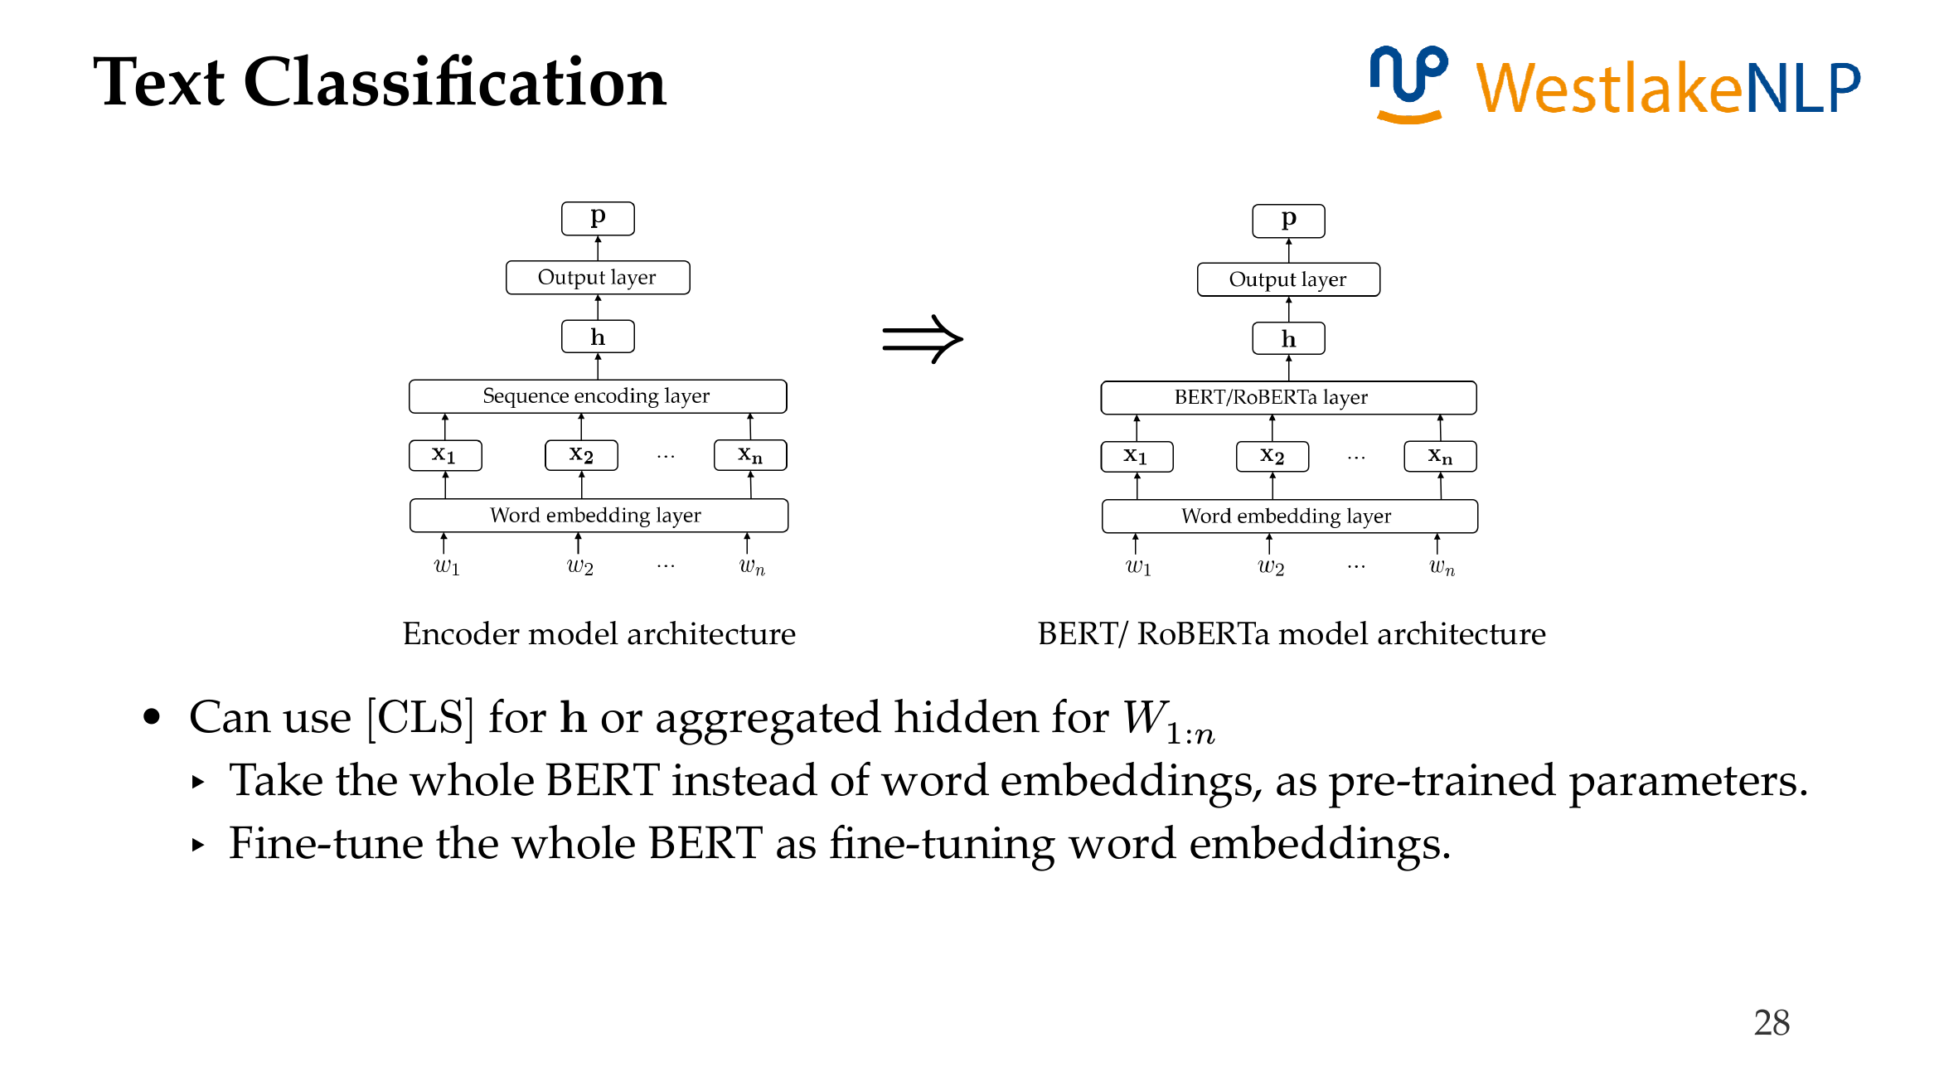

Slide 35
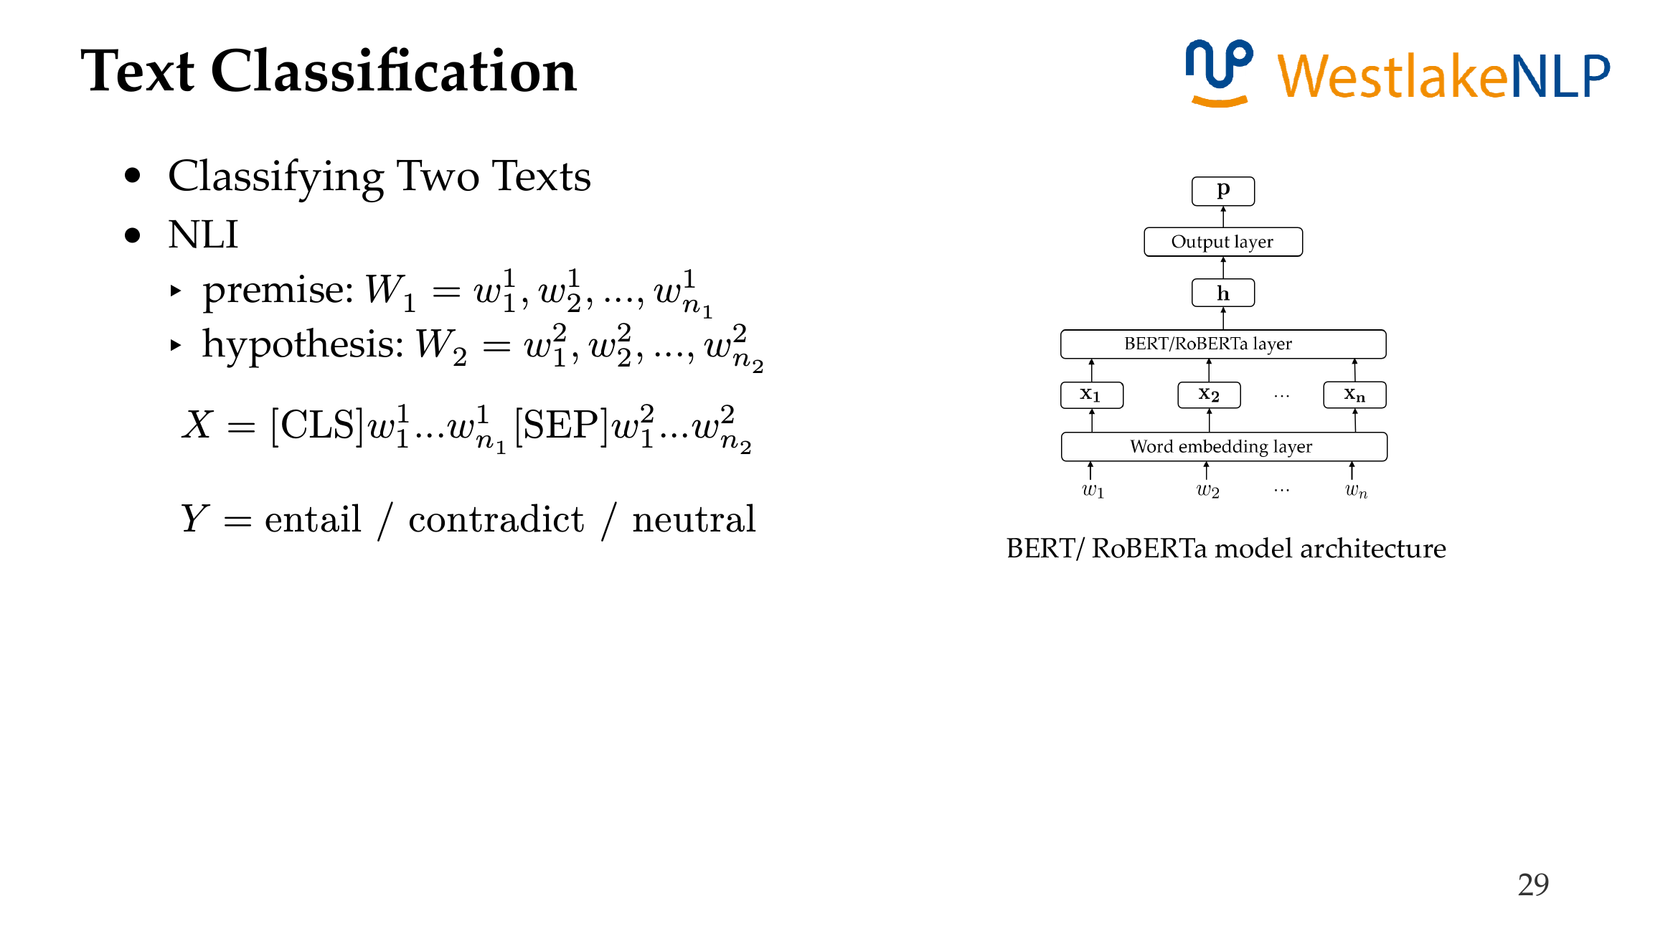

Slide 36
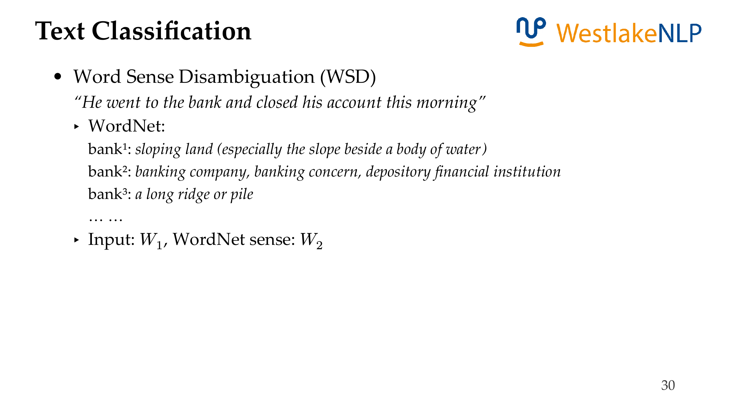

Slide 37
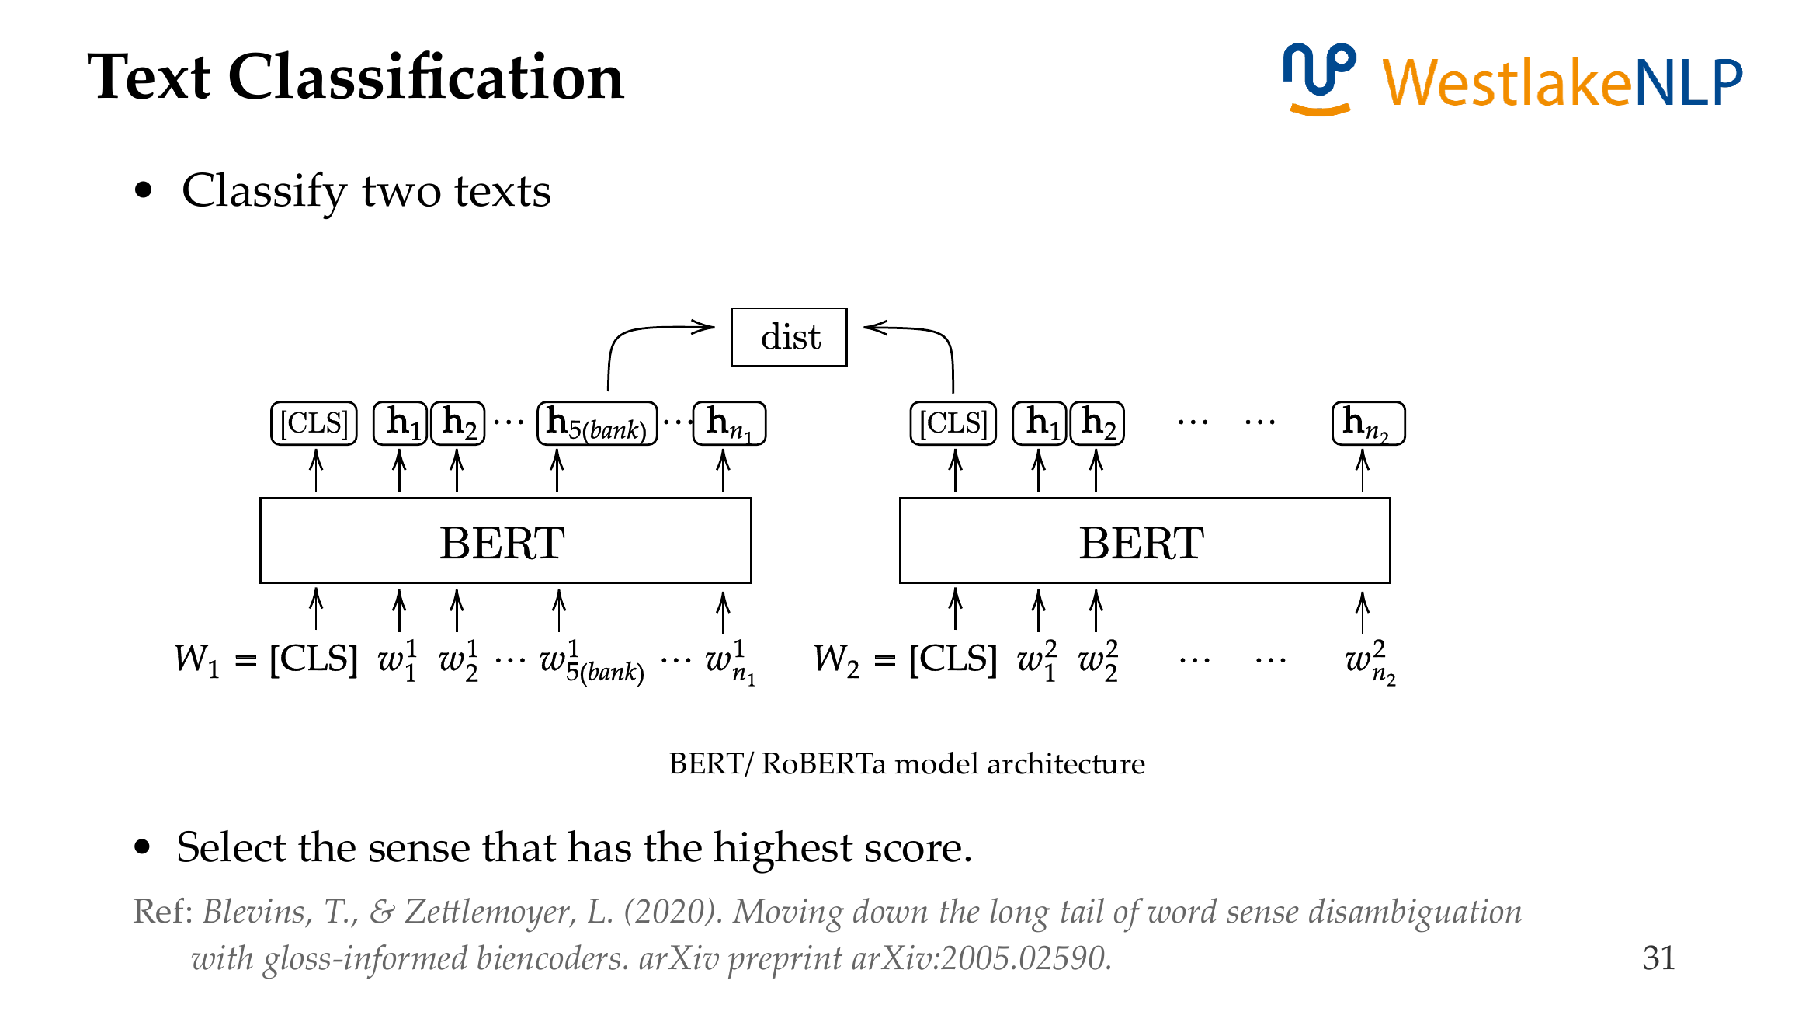
Can use two different BERT models.
Blevins, T., & Zettlemoyer, L. (2020). Moving down the long tail of word sense disambiguation with gloss informed bi-encoders. In Proceedings of the 58th Annual Meeting of the Association for Computational Linguistics.

Slide 38



D
I
D
Test data can be in a certain domain.
Gururangan, S., Marasović, A., Swayamdipta, S., Lo, K., Beltagy, I., Downey, D., & Smith, N. A. (2020). Don't stop pretraining: Adapt language models to domains and tasks. In Proceedings of the 58th Annual Meeting of the Association for Computational Linguistics.

Slide 39








Tuning pretrained language models can be very costly

Slide 40



Residual adapter

Slide 41







Attention Adapter
Alternative attention adapter form

Slide 42


Define arbitrary adapter structures

Slide 43


Li, X. L., & Liang, P. (2021). Prefix-tuning: Optimizing continuous prompts for generation. In Proceedings of the 59th Annual Meeting of the Association for Computational Linguistics and the 11th International Joint Conference on Natural Language Processing

Slide 44


Knowledge Distillation
Use a smaller model for more efficiency
Use the original model to teach the smaller model
Objective function
- distillation
- hidden

Slide 45
Content
13.1 Transformer Pre-training
13.1.1 GPT: Generative Pre-Training
13.1.2 BERT: Bidirectional Encoder Representations from Transformer
13.1.3 BART: Bidirectional and Auto-Regressive Transformer
13.2 Using Pre-trained Transformer for Solving NLP Tasks
13.2.1 Text Classification
13.2.2 Structured Prediction
13.2.3 Generation
13.3 Analyzing Pre-trained Models
13.3.1 Analyzing BERT
13.3.2 Knowledge in Pretrained LM
13.3.3 Language Models Take Shortcuts

Slide 46


Add structured prediction output layers

Slide 47
Event Extraction
Trigger detection
Visit/Attack/Move/…
Visit/Attack/Move/…
Visit/Attack/Move/…
Visit/Attack/Move/…
Visit/Attack/Move/…
0/1
0/1
0/1
0/1
0/1
BERT
Jason
visited
Byte
Dance
.

Slide 48

Event Extraction
Argument detection
visitor /
visitee /
None
visitor /
visitee /
None
visitor /
visitee /
None
visitor /
visitee /
None
=
visited
1
visited
2
visited
3
visited
4
visited
5
BERT
Jason
visited
Byte
Dance
.

Slide 49


Slide 50



Machine Reading Comprehension

Slide 51
Machine Reading Comprehension

Slide 52


Table QA
Pan, F., Canim, M., Glass, M., Gliozzo, A., & Fox, P. (2021). CLTR: An end-to-end, transformer-based system for cell-level table retrieval and table question answering. In Proceedings of the 59th Annual Meeting of the Association for Computational Linguistics and the 11th International Joint Conference on Natural Language Processing: System Demonstrations.

Slide 53




Template-based BART NER, template:
Notes:
Leyang cui, Bart paper citation, the citation now is wrong!

Slide 54



Li, S., Ji, H., & Han, J. (2021). Document-level event argument extraction by conditional generation. Proceedings of the 2021 Conference of the North American Chapter of the Association for Computational Linguistics: Human Language Technologies .

Slide 55
Content
13.1 Transformer Pre-training
13.1.1 GPT: Generative Pre-Training
13.1.2 BERT: Bidirectional Encoder Representations from Transformer
13.1.3 BART: Bidirectional and Auto-Regressive Transformer
13.2 Using Pre-trained Transformer for Solving NLP Tasks
13.2.1 Text Classification
13.2.2 Structured Prediction
13.2.3 Generation
13.3 Analyzing Pre-trained Models
13.3.1 Analyzing BERT
13.3.2 Knowledge in Pretrained LM
13.3.3 Language Models Take Shortcuts

Slide 56


Open Question Answering
Input: a question $W^{q}$ and the Internet
Output: the answer to the question
Idea: retrieve then reading comprehension
Method：
First, retrieve k relevant passages${ W}_{1}^{r},W_{2}^{r}, …,W_{k}^{r}$
Second, concatenate (${{ W^{q}W}_{1}^{r},{W^{q}W}_{2}^{r}, …,W^{q}W_{k}^{r} }^{ }$)
Third, predict answer using BART
Chen, D., Fisch, A., Weston, J., & Bordes, A. (2017). Reading Wikipedia to answer open-domain questions. Proceedings of the 55th Annual Meeting of the Association for Computational Linguistics

Slide 57



Slide 58




Slide 59






dist
RoBERTa

Slide 60




Start with a full vocabulary of words, characters and subwords(using common sub sequences, or BPE)
incrementally remove tokens to maximize unigram LM
< /s > as the end

Slide 61


Slide 62







AMR to Text Generation

Slide 63

AMR to Text Generation

Slide 64



AMR to Text Generation
Ribeiro, L. F. R., Zhang, Y., & Gurevych, I. (2021). Structural adapters in pretrained language models for AMR-to-text generation. Proceedings of the 2021 Conference on Empirical Methods in Natural Language Processing .
Notes:
#

Slide 65




AMR to Text Generation
Bai, X., Chen, Y., & Zhang, Y. (2022). Graph pre-training for AMR parsing and generation. Proceedings of the 60th Annual Meeting of the Association for Computational Linguistics

Slide 66
Content
13.1 Transformer Pre-training
13.1.1 GPT: Generative Pre-Training
13.1.2 BERT: Bidirectional Encoder Representations from Transformer
13.1.3 BART: Bidirectional and Auto-Regressive Transformer
13.2 Using Pre-trained Transformer for Solving NLP Tasks
13.2.1 Text Classification
13.2.2 Structured Prediction
13.2.3 Generation
13.3 Analyzing Pre-trained Models
13.3.1 Analyzing BERT
13.3.2 Knowledge in Pretrained LM
13.3.3 Language Models Take Shortcuts

Slide 67


Analyze attention pattern
Clark, K., Khandelwal, U., Levy, O., & Manning, C. D. (2019). What does BERT look at? An analysis of BERT's attention. Proceedings of the 2019 ACL Workshop BlackboxNLP

Slide 68


Slide 69

Liu, N. F., Gardner, M., Belinkov, Y., Peters, M. E., & Smith, N. A. (2019). Linguistic knowledge and transferability of contextual representations. Proceedings of the 2019 Conference of the North American Chapter of the Association for Computational Linguistics

Slide 70



Slide 71

Tenney, I., Xia, P., Chen, B., Wang, A., Poliak, A., McCoy, R. T., Kim, N., Van Durme, B., Bowman, S. R., Das, D., & Pavlick, E. (2019). What do you learn from context? Probing for sentence structure in contextualized word representations. ICLR (Poster) .

Slide 72


Slide 73
Content
13.1 Transformer Pre-training
13.1.1 GPT: Generative Pre-Training
13.1.2 BERT: Bidirectional Encoder Representations from Transformer
13.1.3 BART: Bidirectional and Auto-Regressive Transformer
13.2 Using Pre-trained Transformer for Solving NLP Tasks
13.2.1 Text Classification
13.2.2 Structured Prediction
13.2.3 Generation
13.3 Analyzing Pre-trained Models
13.3.1 Analyzing BERT
13.3.2 Knowledge in Pretrained LM
13.3.3 Language Models Take Shortcuts

Slide 74



Knowledge in Pretrained LM
Knowledge in BERT
Heinzerling, B., & Inui, K. (2021). Language models as knowledge bases: On entity representations, storage capacity, and paraphrased queries. Proceedings of the 16th Conference of the European Chapter of the Association for Computational Linguistics

Slide 75

Knowledge in Pretrained LM
• Finetune BERT on open QA
• Answers other open questions
Sep 2 , 1945 </S>
encoder
decoder
When did WWII end ？
<S> Sep 2 , 1945
Roberts, A., Raffel, C., & Shazeer, N. (2020). How much knowledge can you pack into the parameters of a language model? Proceedings of the 2020 Conference on Empirical Methods in Natural Language Processing (EMNLP) .

Slide 76

Knowledge in Pretrained LM
•Does BERT contain commonsense knowledge ?
• Transform commonsense KG → sentences (using templates)
(musician, CapableOf, play musical instrument) → “A musician can play a musical instrument.”
• Calculate e₁ , e₂ :
PMI(e₁, e₂ | r) = log P(e₂ | e₁, r) – log P(e₂ | r)
P(e₁, e₂ | r) calculated by MLM (phrase e₂ as product of word probabilities)
P(e₁ | r) calculated by MLM, masking e₂ also.
ConceptNet
Davison, J., Feldman, J., & Rush, A. M. (2019). Commonsense knowledge mining from pretrained models. Proceedings of the 2019 Conference on Empirical Methods in Natural Language Processing and the 9th International Joint Conference on Natural Language Processing (EMNLP-IJCNLP) .

Slide 77

Knowledge in Pretrained LM
Measure LM probabilities of sentences or sentence pairs
Zhou, X., Zhang, Y., Cui, L., & Huang, D. (2020). Evaluating Commonsense in Pre-Trained Language Models. Proceedings of the AAAI Conference on Artificial Intelligence

Slide 78

Knowledge in Pretrained LM
Logical reasoning
Proof
Writer
Tafjord, O., Dalvi, B., & Clark, P. (2021). ProofWriter: Generating implications, proofs, and abductive statements over natural language. Findings of the Association for Computational Linguistics: ACL-IJCNLP 2021 .

Slide 79

Knowledge in Pretrained LM
Logical reasoning
Liu, J., Cui, L., Liu, H., Huang, D., Wang, Y., & Zhang, Y. (2021). LogiQA: A challenge dataset for machine reading comprehension with logical reasoning. Proceedings of the 29th International Joint Conference on Artificial Intelligence .

Slide 80
Content
13.1 Transformer Pre-training
13.1.1 GPT: Generative Pre-Training
13.1.2 BERT: Bidirectional Encoder Representations from Transformer
13.1.3 BART: Bidirectional and Auto-Regressive Transformer
13.2 Using Pre-trained Transformer for Solving NLP Tasks
13.2.1 Text Classification
13.2.2 Structured Prediction
13.2.3 Generation
13.3 Analyzing Pre-trained Models
13.3.1 Analyzing BERT
13.3.2 Knowledge in Pretrained LM
13.3.3 Language Models Take Shortcuts

Slide 81

Language Models Take Shortcuts
Hypothesis-Only Natural Language Inference
Poliak, A., Naradowsky, J., Haldar, A., Rudinger, R., & Van Durme, B. (2018). Hypothesis only baselines in natural language inference. Proceedings of the 7th Joint Conference on Lexical and Computational Semantics .

Slide 82


Language Models Take Shortcuts
Data artifacts causes shortcuts
PMI(word, label) = log $\frac{\text{P}\text{(}\text{word}\text{, }\text{label}\text{)}}{\text{P}\text{(}\text{word}\text{) }\text{P}\text{(}\text{label}\text{)}}$
Gururangan, S., Swayamdipta, S., Levy, O., Schwartz, R., Bowman, S., & Smith, N. A. (2018). Annotation artifacts in natural language inference data. Proceedings of the 2018 Conference of the North American Chapter of the Association for Computational Linguistics: Human Language Technologies

Slide 83

Language Models Take Shortcuts
Shortcut in Machine Reading Comprehension
Sugawara, S., Inui, K., Sekine, S., & Aizawa, A. (2018). What makes reading comprehension questions easier? Proceedings of the 2018 Conference on Empirical Methods in Natural Language Processing .

Slide 84
Language Models Take Shortcuts
Shortcut in open QA
Question overlap:
similar train / test questions
Answer overlap
the same answer for different questions etc.
Lewis, P., Stenetorp, P., & Riedel, S. (2021). Question and answer test-train overlap in open-domain question answering datasets. Proceedings of the 16th Conference of the European Chapter of the Association for Computational Linguistics: Main Volume .
Wang, C., Liu, P., & Zhang, Y. (2021). Can generative pre-trained language models serve as knowledge bases for closed-book QA? Proceedings of the 59th Annual Meeting of the Association for Computational Linguistics and the 11th International Joint Conference on Natural Language Processing

Slide 85

Language Models Take Shortcuts
Shortcuts are spurious features
Rationale — human reason
Spurious patterns — wrong feature
Yang, L., Zhang, S., Qin, L., Li, Y., Wang, Y., Liu, H., Wang, J., Xie, X., & Zhang, Y. (2023). GLUE-X: Evaluating natural language understanding models from an out-of-distribution generalization perspective. Findings of the Association for Computational Linguistics: ACL 2023 .

Slide 86

Language Models Take Shortcuts
Shortcuts lead to low out-of-distribution (OOD) results
Yang, L., Zhang, S., Qin, L., Li, Y., Wang, Y., Liu, H., Wang, J., Xie, X., & Zhang, Y. (2023). GLUE-X: Evaluating natural language understanding models from an out-of-distribution generalization perspective. Findings of the Association for Computational Linguistics: ACL 2023 .

Slide 87

Adversarial Test
Disturb the original distribution
adding one irrelevant sentence to the passage that does not affect the answer output.
Jia, R., & Liang, P. (2017). Adversarial examples for evaluating reading comprehension systems. Proceedings of the 2017 Conference on Empirical Methods in Natural Language Processing .

Slide 88

Adversarial Test
The effect of negation
Hossain, M. M., Kovatchev, V., Dutta, P., Kao, T., Wei, E., & Blanco, E. (2020). An analysis of natural language inference benchmarks through the lens of negation. Proceedings of the 2020 Conference on Empirical Methods in Natural Language Processing (EMNLP) .

Slide 89
Summary
In this week, we have learned：
• Pre-trained Transformer models,
GPT, BERT, BART.
• Using the pre-trained Transformer models, for solving NLP tasks.
• Analyzing pre-trained Transformer models.

